Slide 1

50.039 Theory and Practice of Deep Learning W4-S1 Introduction to Computer Vision and Convolutional Neural Networks
Matthieu De Mari

Slide 2
About this week (Week 4)
What are images and how is this datatype represented?
What is a pixel and how can its information be interpreted?
What is the spatial dependence property of pixels?
What is the homophily property of pixels?
Why is the linear processing operation failing on images?
What is the convolution operation?
How can we perform image processing using convolutions?
What is padding in convolutions?

Slide 3
About this week (Week 4)
What is stride in convolution?
What is dilation in convolution?
How does convolution apply to higher dimensional images?
How to write our own convolutional processing layer in PyTorch?
What is Conv2d in PyTorch?
What is a Convolutional Neural Network (CNN)?
What is the intuition behind using Convolutional layers in a Convolutional Neural Network?

Slide 4
About this week (Week 4)
How to train our first Convolutional Neural Network on MNIST?
What are other typical image processing layers in Computer Vision and how are they implemented?
What is the pooling layer?
What is the batchnorm layer?
What is the dropout layer?
What is data augmentation in Computer Vision?
What are some milestone Computer Vision models and their contributions to the field of Deep Learning?

Slide 5
About this week (Week 4)
What are the AlexNet and VGG models?
What is a skip connection/residual? What is its effect on a Neural Network and how does it help with vanishing gradient problems?
What are ResNet and DenseNet models?
What is the Inception model?
What is the EfficientNet model?
What is transfer learning and its uses?
How to freeze and fine-tune layers in a Neural Network?

Slide 6
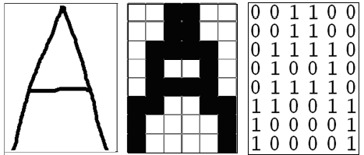
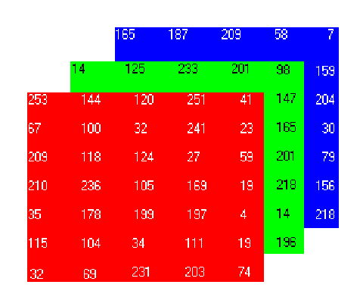
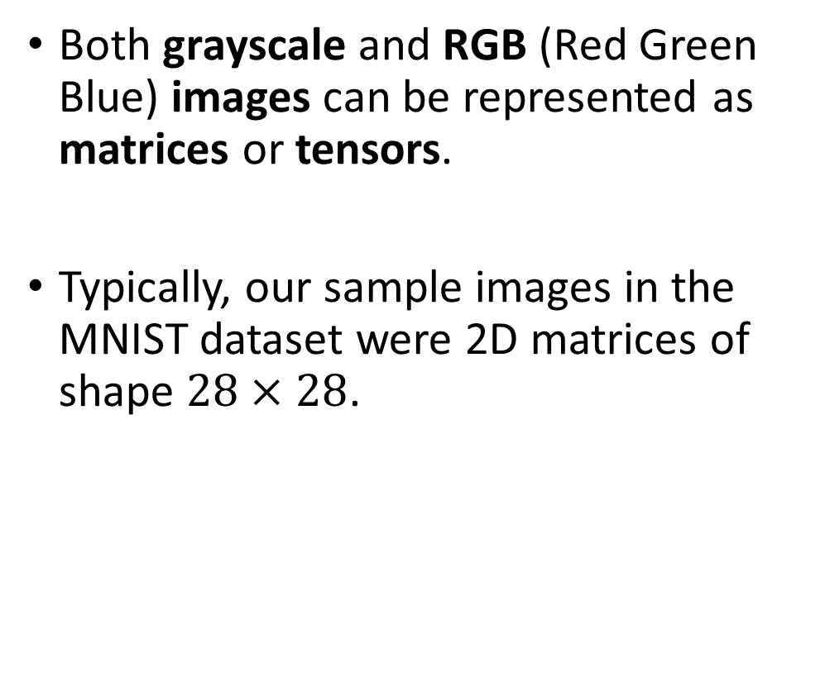
How to encode an image
Both grayscale and RGB (Red Green Blue) images can be represented as matrices or tensors.
Typically, our sample images in the MNIST dataset were 2D matrices of shape $28×28$.

Slide 7
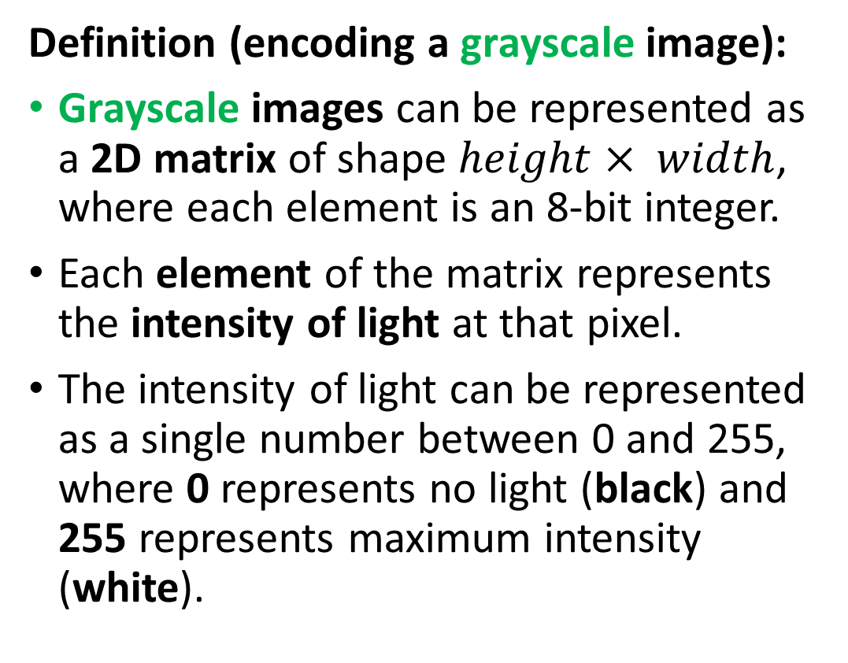
How to encode an image
Definition (encoding a grayscale image):
Grayscale images can be represented as a 2D matrix of shape $height× width$, where each element is an 8-bit integer.
Each element of the matrix represents the intensity of light at that pixel.
The intensity of light can be represented as a single number between 0 and 255, where 0 represents no light (black) and 255 represents maximum intensity (white).

Slide 8
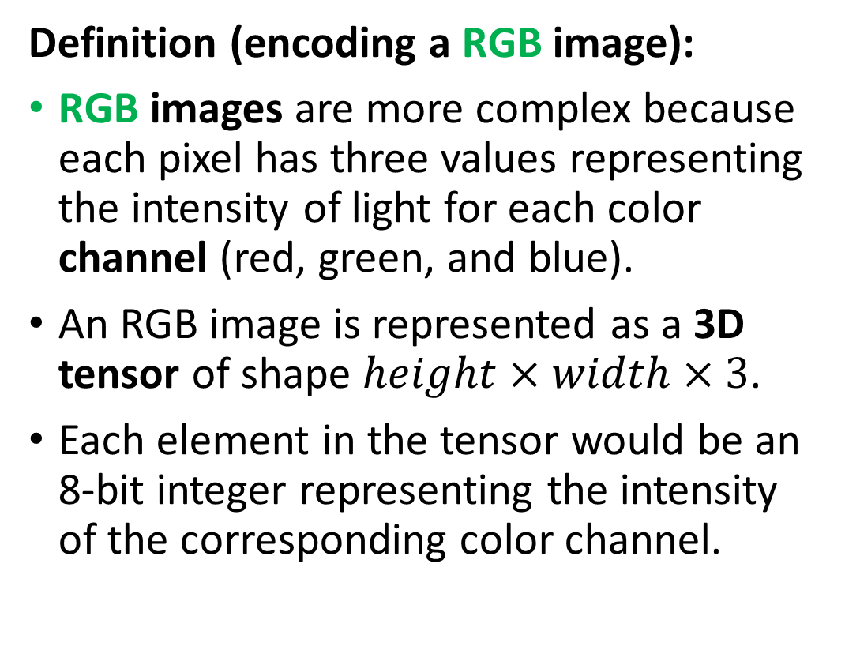
How to encode an image
Definition (encoding a RGB image):
RGB images are more complex because each pixel has three values representing the intensity of light for each color channel (red, green, and blue).
An RGB image is represented as a 3D tensor of shape $height×width×3$.
Each element in the tensor would be an 8-bit integer representing the intensity of the corresponding color channel.

Slide 9
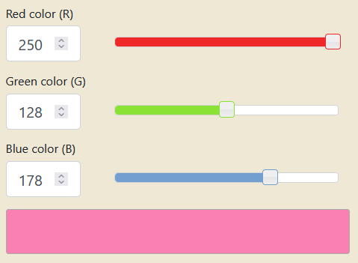
How to encode an image
Combining the red, green and blue values allows to generate any color. Try it!
https://www.rapidtables.com/convert/color/rgb-to-hex.html

Slide 10
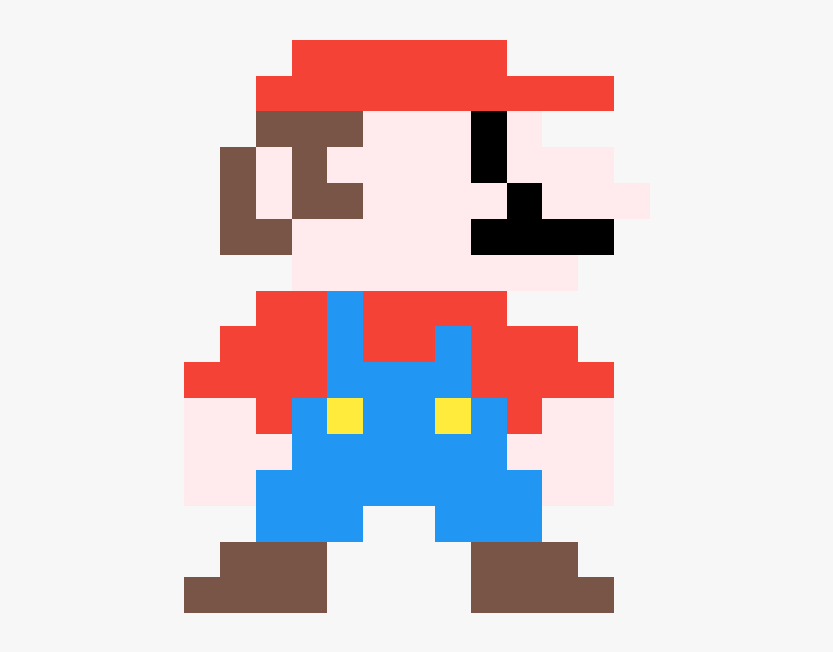
Pixels information
Each element in a Greyscale matrix or RGB matrix corresponds to a pixel, representing something in the image.
The problem, however, is that it is often impossible to guess the meaning of a given pixel, by looking at a pixel alone.

Slide 11
Pixels information
Can you guess what this pixel represents and what object it belongs to?
Flower petal
Piece of clothing
Skin of a human person
Feather of a bird

Slide 12
Pixels information
What if I show you some neighbouring pixels now?
Flower petal
Piece of clothing
Skin of a human person
Feather of a bird

Slide 13
Pixels information
What if I show you MORE neighbouring pixels now?
Flower petal
Piece of clothing
Skin of a human person
Feather of a bird

Slide 14
Pixels information
What if I show you MORE neighbouring pixels now?
Flower petal
Piece of clothing
Skin of a human person
Feather of a bird

Slide 15
The spatial dependence property
Definition (the spatial dependence property of pixels):
The spatial dependence property of pixels states that the meaning or interpretation of a single pixel in an image can often only be understood in the context of the pixels around it.
This is because the information in a single pixel is often not enough to describe the complete picture, or even just the pixel itself.
The relationship between the given pixel and its neighbouring pixels is necessary to provide a full understanding of this particular pixel, or even the image as a whole.
This is something we observed in the Mario pixel art example.

Slide 16
The homophily property
Definition (the homophily property of pixels):
Homophily in images refers to the phenomenon where pixels that are close to each other in space tend to have similar properties, such as color, texture, or intensity. In other words, is the tendency for similar pixels to be grouped together.
For example, in an image of a sky, pixels that are close to each other and have a similar blue color can often be grouped together and be considered part of the sky region.
This property is a key factor in image processing and computer vision algorithms, as it provides a way to segment images into meaningful regions and perform tasks like object recognition and image classification.

Slide 17
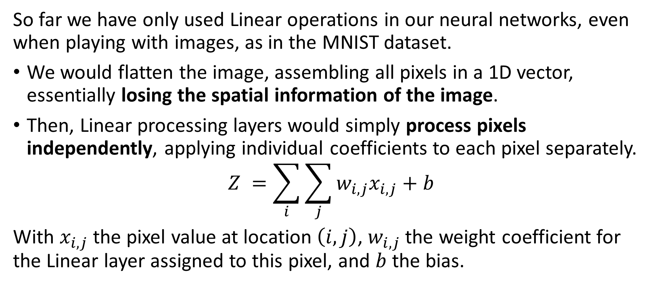
The problem with Linear processing
So far we have only used Linear operations in our neural networks, even when playing with images, as in the MNIST dataset.
We would flatten the image, assembling all pixels in a 1D vector, essentially losing the spatial information of the image.
Then, Linear processing layers would simply process pixels independently, applying individual coefficients to each pixel separately.
$$Z =\sum_{i}{\sum_{j}{w_{i,j}x_{i,j}+b}}$$
With $x_{i,j}$ the pixel value at location $\left(i,j\right)$, $w_{i,j}$ the weight coefficient for the Linear layer assigned to this pixel, and $b$ the bias.

Slide 18
The problem with Linear processing
Linear layers are not great at processing images because they do not take into account the spatial dependence of pixels.
Pixels in images are typically related to each other in a spatial manner, i.e. the meaning of a pixel depends on the neighbour pixels.
Unfortunately, linear models would assume each pixel is independent of the others and process them independently, which is not correct.
As a result, linear layers can miss important spatial relationships between pixels. This can, in turn, result in poor image representation and interpretation.
→ Need for a more specific processing operation for images, to use in place of the Linear one!

Slide 19
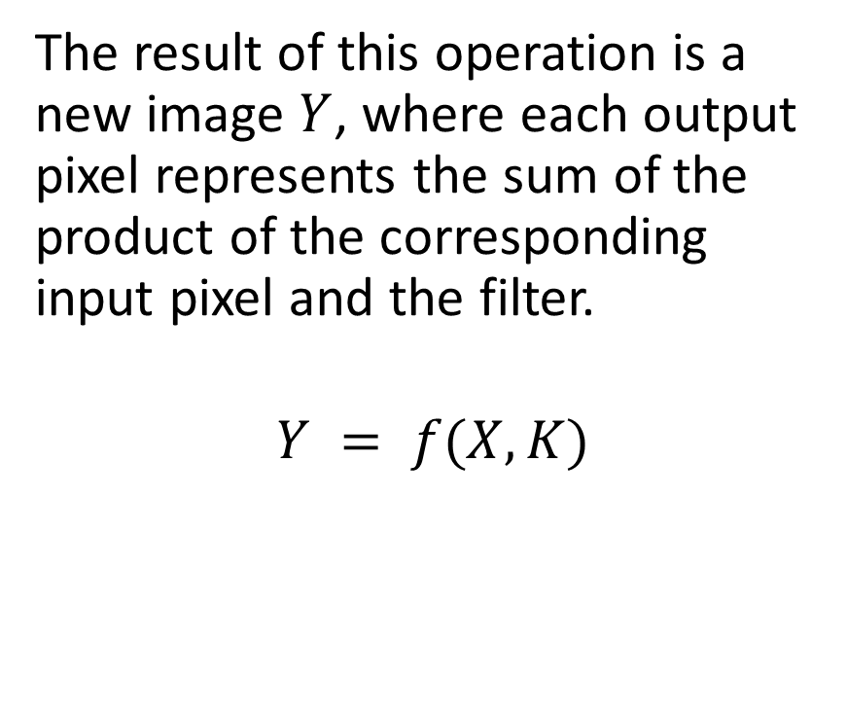
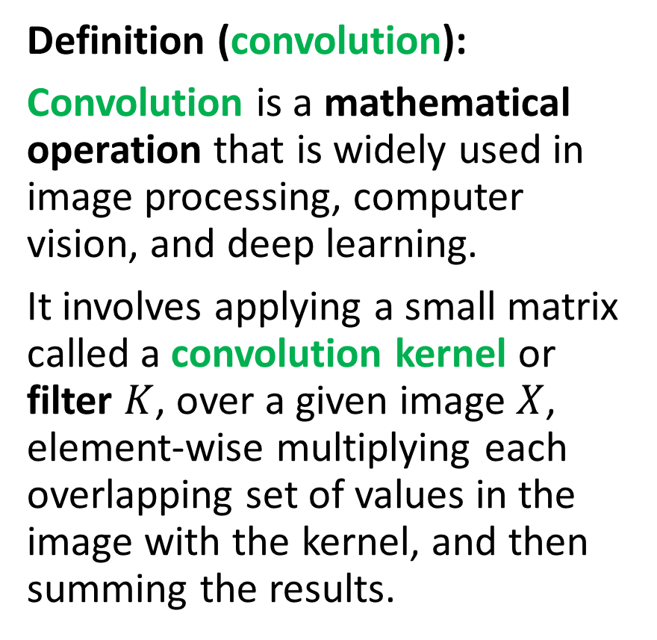
Introducing convolution!
Definition (convolution):
Convolution is a mathematical operation that is widely used in image processing, computer vision, and deep learning.
It involves applying a small matrix called a convolution kernel or filter $K$, over a given image $X$, element-wise multiplying each overlapping set of values in the image with the kernel, and then summing the results.
The result of this operation is a new image $Y$, where each output pixel represents the sum of the product of the corresponding input pixel and the filter.
$$Y = f(X, K)$$

Slide 20
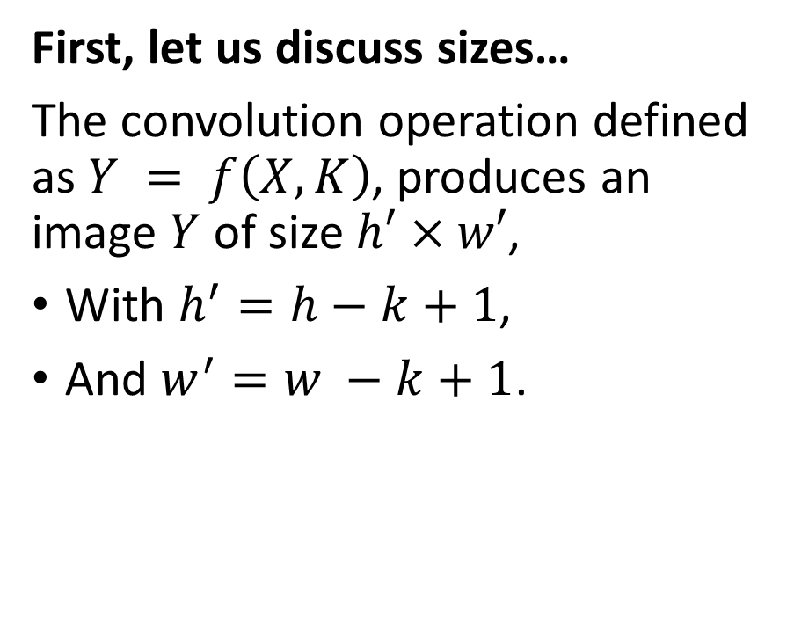
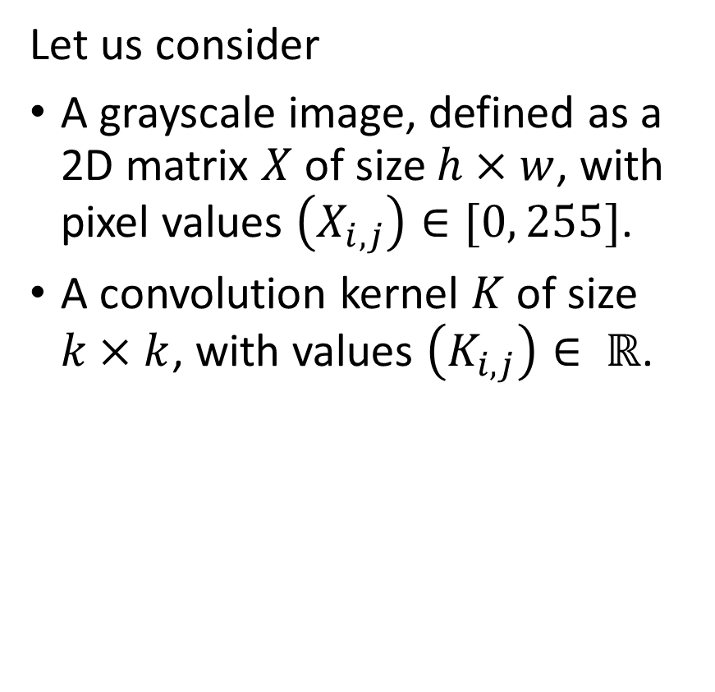
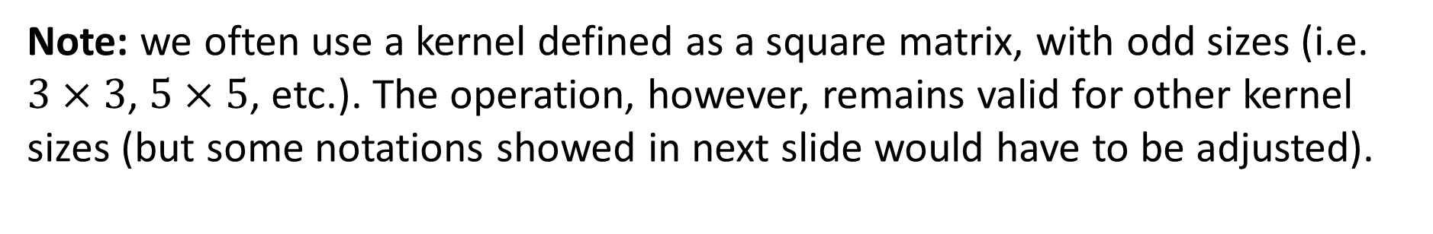
Introducing convolution!
Let us consider
A grayscale image, defined as a 2D matrix $X$ of size $h×w$, with pixel values $\left(X_{i,j}\right)∈[0, 255]$.
A convolution kernel $K$ of size $k×k$, with values $\left(K_{i,j}\right)∈ ℝ$.
First, let us discuss sizes…
The convolution operation defined as $Y = f\left(X, K\right)$, produces an image $Y$ of size $h′×w′$,
With $h^{′}=h−k+1$,
And $w^{′}=w −k+1$.
Note: we often use a kernel defined as a square matrix, with odd sizes (i.e. $3×3$, $5×5$, etc.). The operation, however, remains valid for other kernel sizes (but some notations showed in next slide would have to be adjusted).

Slide 21

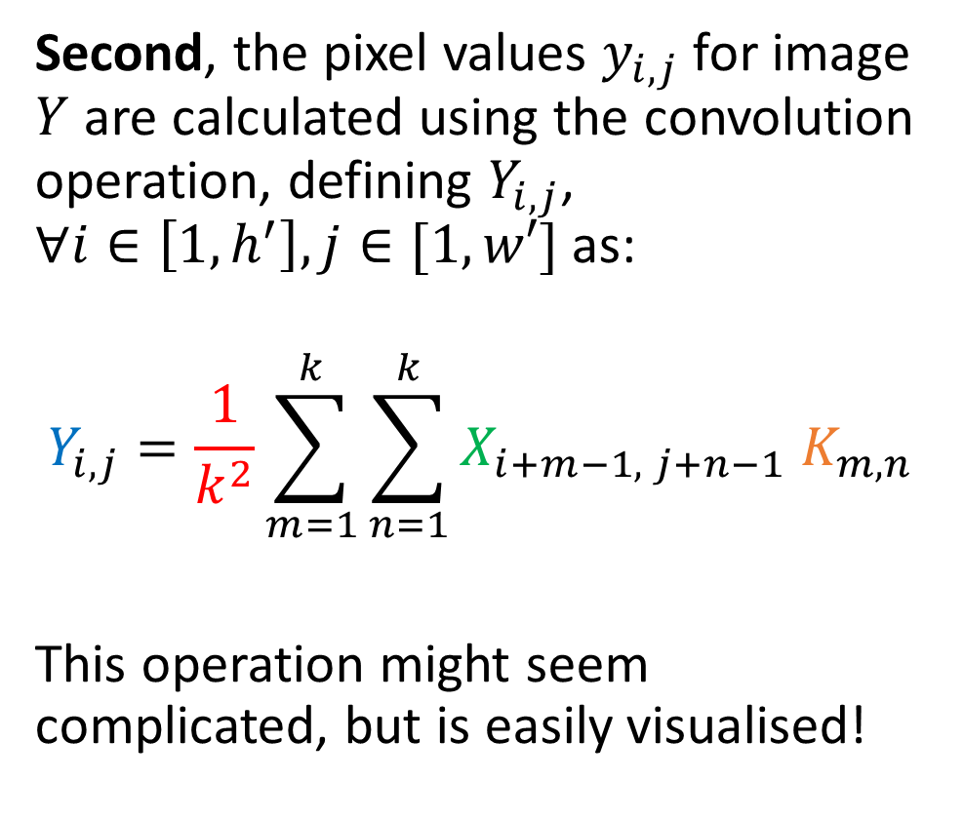


Introducing convolution!
1 | 2 | 4 | 2 | 1
4 | 7 | 3 | 2 | 1
4 | 5 | 2 | 3 | 1
2 | 1 | 7 | 8 | 4
3 | 2 | 4 | 7 | 8
X is 5 by 5
K is 3 by 3
Y is therefore 3 by 3.
(5-3+1 = 3)
$$X$$
Second, the pixel values $y_{i,j}$for image $Y$ are calculated using the convolution operation, defining $Y_{i,j}$, $∀i∈\left[1, h^{′}\right], j∈[1,w′]$ as:
$$Y_{i,j}=\frac{1}{k^{2}}\sum_{m=1}^{k}{\sum_{n=1}^{k}{X_{i+m−1, j+n−1} K_{m,n}}}$$
This operation might seem complicated, but is easily visualised!
1 | 0 | 1
0 | 2 | 1
1 | 0 | 1
$$K$$
… | … | …
… | … | …
… | … | …
$$Y$$

Slide 22

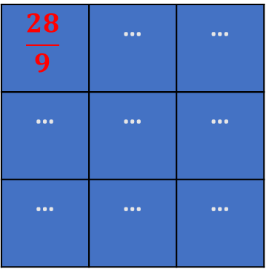
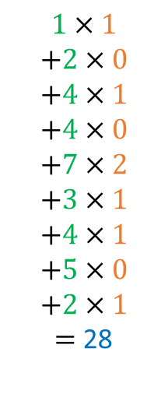
Introducing convolution!
1 | 2 | 4 | 2 | 1
4 | 7 | 3 | 2 | 1
4 | 5 | 2 | 3 | 1
2 | 1 | 7 | 8 | 4
3 | 2 | 4 | 7 | 8
$$1×1$$
$$+2×0$$
$$+4×1$$
$$+4×0$$
$$+7×2$$
$$+3×1$$
$$+4×1$$
$$+5×0$$
$$+2×1$$
$=$ 28
$$X$$
Second, the pixel values $y_{i,j}$for image $Y$ are calculated using the convolution operation, defining $Y_{i,j}$, $∀i∈\left[1, h^{′}\right], j∈[1,w′]$ as:
$$Y_{i,j}=\frac{1}{k^{2}}\sum_{m=1}^{k}{\sum_{n=1}^{k}{X_{i+m−1, j+n−1} K_{m,n}}}$$
This operation might seem complicated, but is easily visualised!
1 | 0 | 1
0 | 2 | 1
1 | 0 | 1
$$K$$
$$\frac{28}{9}$$ | … | …
… | … | …
… | … | …
$$Y$$

Slide 23
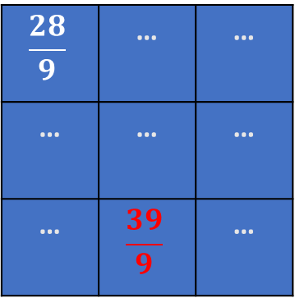
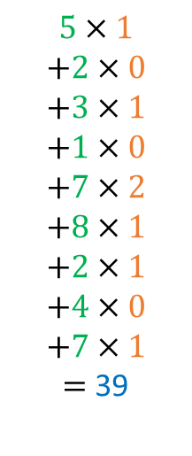
Introducing convolution!
1 | 2 | 4 | 2 | 1
4 | 7 | 3 | 2 | 1
4 | 5 | 2 | 3 | 1
2 | 1 | 7 | 8 | 4
3 | 2 | 4 | 7 | 8
$$5×1$$
$$+2×0$$
$$+3×1$$
$$+1×0$$
$$+7×2$$
$$+8×1$$
$$+2×1$$
$$+4×0$$
$$+7×1$$
$=$ 39
$$X$$
Second, the pixel values $y_{i,j}$for image $Y$ are calculated using the convolution operation, defining $Y_{i,j}$, $∀i∈\left[1, h^{′}\right], j∈[1,w′]$ as:
$$Y_{i,j}=\frac{1}{k^{2}}\sum_{m=1}^{k}{\sum_{n=1}^{k}{X_{i+m−1, j+n−1} K_{m,n}}}$$
This operation might seem complicated, but is easily visualised!
1 | 0 | 1
0 | 2 | 1
1 | 0 | 1
$$K$$
$$\frac{28}{9}$$ | … | …
… | … | …
… | $$\frac{39}{9}$$ | …
$$Y$$

Slide 24

Introducing convolution!
1 | 2 | 4 | 2 | 1
4 | 7 | 3 | 2 | 1
4 | 5 | 2 | 3 | 1
2 | 1 | 7 | 8 | 4
3 | 2 | 4 | 7 | 8
$$5×1$$
$$+2×0$$
$$+3×1$$
$$+1×0$$
$$+7×2$$
$$+8×1$$
$$+2×1$$
$$+4×0$$
$$+7×1$$
$=$ 39
$$X$$
Second, the pixel values $y_{i,j}$for image $Y$ are calculated using the convolution operation, defining $Y_{i,j}$, $∀i∈\left[1, h^{′}\right], j∈[1,w′]$ as:
$$Y_{i,j}=\frac{1}{k^{2}}\sum_{m=1}^{k}{\sum_{n=1}^{k}{X_{i+m−1, j+n−1} K_{m,n}}}$$
1 | 0 | 1
0 | 2 | 1
1 | 0 | 1
$$K$$
$$\frac{28}{9}$$ | … | …
… | … | …
… | $$\frac{39}{9}$$ | …
$$Y$$
Note: Sometimes, the normalization term is removed and we may instead normalize the kernel (ensuring elements in kernel matrix sum up to 1), or not.

Slide 25
Introducing convolution!
1 | 2 | 4 | 2 | 1
4 | 7 | 3 | 2 | 1
4 | 5 | 2 | 3 | 1
2 | 1 | 7 | 8 | 4
3 | 2 | 4 | 7 | 8
$$5×1$$
$$+2×0$$
$$+3×1$$
$$+1×0$$
$$+7×2$$
$$+8×1$$
$$+2×1$$
$$+4×0$$
$$+7×1$$
$=$ 39
$$X$$
Second, the pixel values $y_{i,j}$for image $Y$ are calculated using the convolution operation, defining $Y_{i,j}$, $∀i∈\left[1, h^{′}\right], j∈[1,w′]$ as:
$$Y_{i,j}=\frac{1}{k^{2}}\sum_{m=1}^{k}{\sum_{n=1}^{k}{X_{i+m−1, j+n−1} K_{m,n}}}$$
1 | 0 | 1
0 | 2 | 1
1 | 0 | 1
$$K$$
$$\frac{28}{9}$$ | … | …
… | … | …
… | $$\frac{39}{9}$$ | …
$$Y$$
→ At the end of the day, convolution is just another type of matrix multiplication!

Slide 26
Convolution and Image Processing courses
Convolution is a key mathematical operation that is widely used in computer vision and image processing to modify the apply a wide range of transformations on an image (enhancing contrast, blurring, edge detection, Instagram filters, etc).
If Computer Vision is a direction that interests you, I would strongly advise to take a course on Image Processing (with implementations in OpenCV, Photoshop, etc.) during your continued learning.
For instance: https://www.udemy.com/course/digital-image-processing-from-ground-up-in-python/

Slide 27
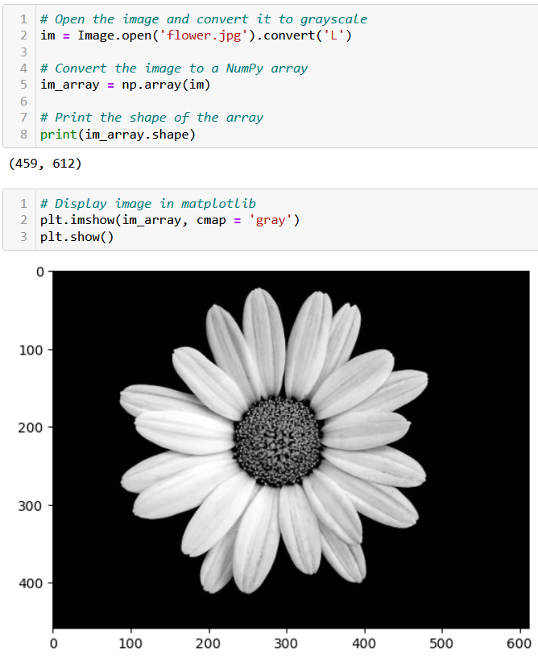
Testing convolution on images
Let us try the convolution operation on images to see their effect.
First, we need a greyscale image.

Slide 28
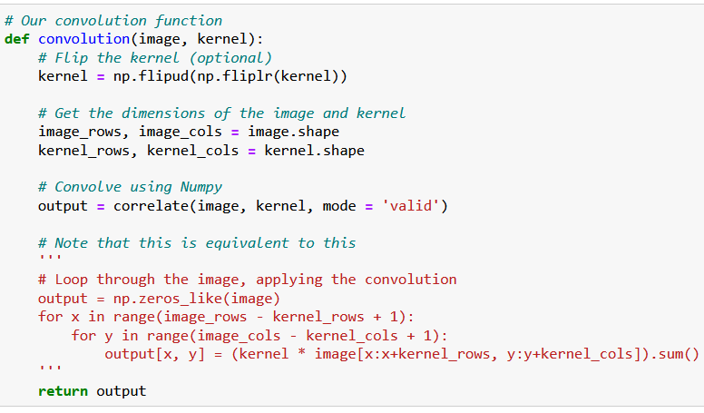
Testing convolution on images
Let us try the convolution operation on images to see their effect.
First, we need a greyscale image.
Second, we need a convolution function.

Slide 29
Testing convolution on images
What is the purpose of flipping the kernel?
Optional, but in short, flipping the kernel has mathematical and practical advantages that make it a common practice in deep learning
(It has to do with signal processing, Fast Fourier Transform and the convolution theorem, out-of-scope).
https://stackoverflow.com/questions/45152473/why-is-the-convolutional-filter-flipped-in-convolutional-neural-networks

Slide 30
Testing convolution on images
Let us try the convolution operation on images to see their effect.
First, we need a greyscale image.
Second, we need a convolution function.
The magic for the transformation then happens when deciding on which kernel to use.

Slide 31
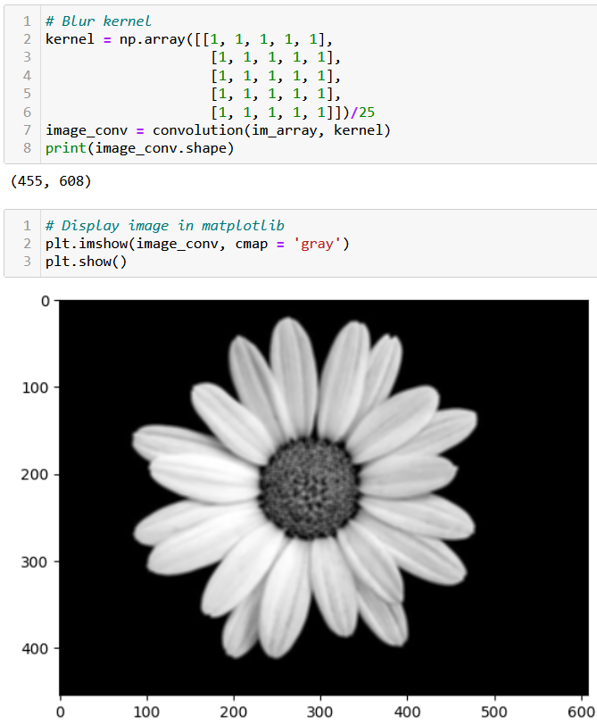
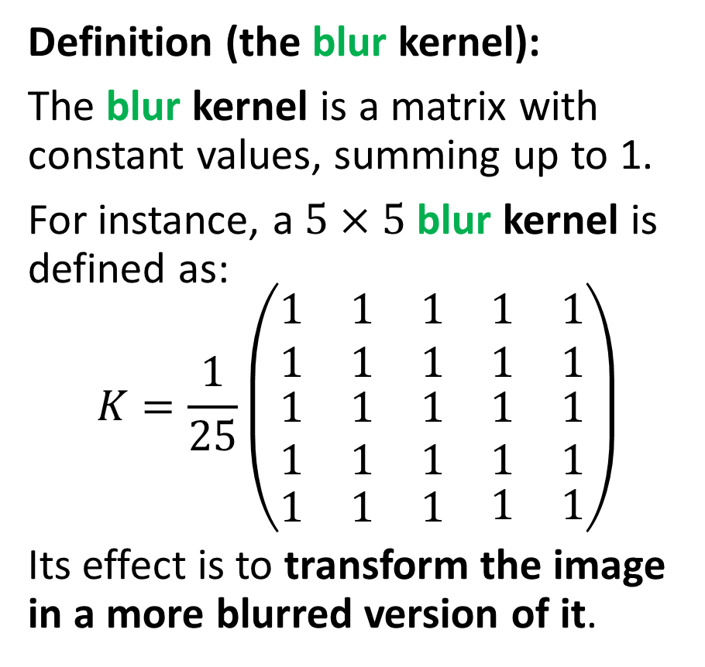
Testing convolution on images
Definition (the blur kernel):
The blur kernel is a matrix with constant values, summing up to 1.
For instance, a $5×5$ blur kernel is defined as:
$$K=\frac{1}{25}\left(\begin{matrix}\begin{matrix}1 & 1 & 1 \\ 1 & 1 & 1\end{matrix} & \begin{matrix}1 \\ 1\end{matrix} & \begin{matrix}1 \\ 1\end{matrix} \\ \begin{matrix}1 & 1 & 1 \\ 1 & 1 & 1\end{matrix} & \begin{matrix}1 \\ 1\end{matrix} & \begin{matrix}1 \\ 1\end{matrix} \\ \begin{matrix}1 & 1 & 1\end{matrix} & 1 & 1\end{matrix}\right)$$
Its effect is to transform the image in a more blurred version of it.

Slide 33
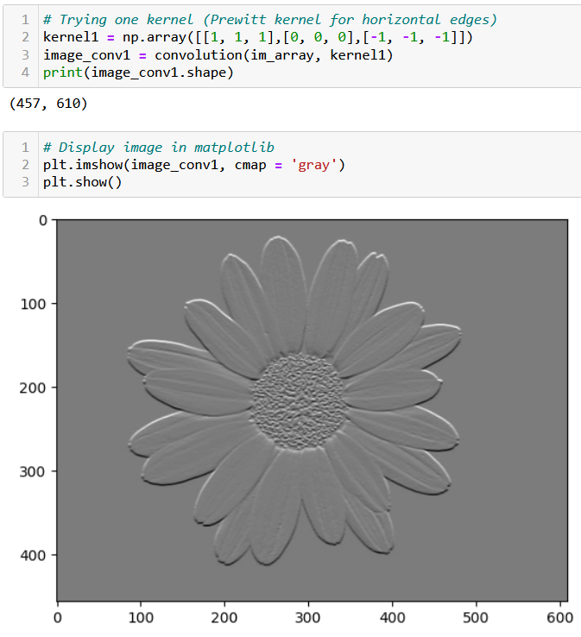
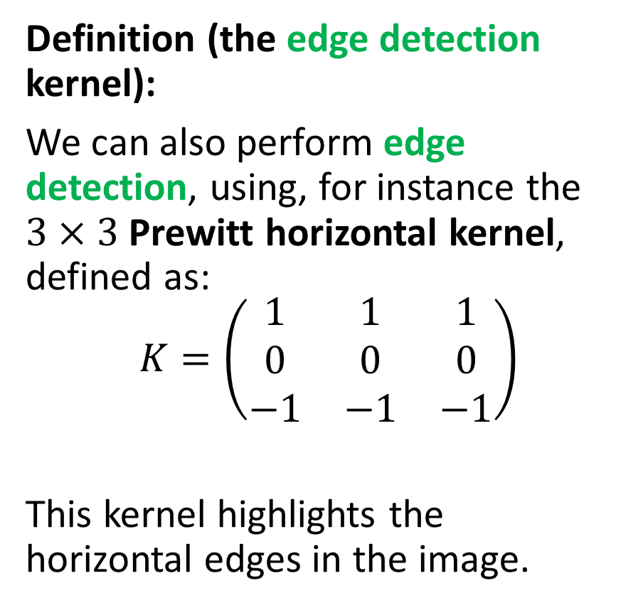
Testing convolution on images
Definition (the edge detection kernel):
We can also perform edge detection, using, for instance the $3×3$ Prewitt horizontal kernel, defined as:
$$K=\left(\begin{matrix}1 & 1 & 1 \\ 0 & 0 & 0 \\ −1 & −1 & −1\end{matrix}\right)$$
This kernel highlights the horizontal edges in the image.

Slide 35
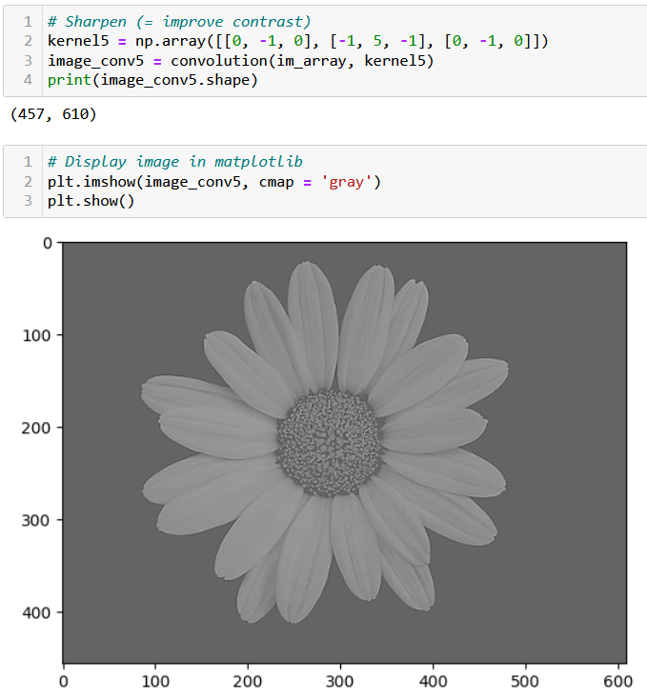
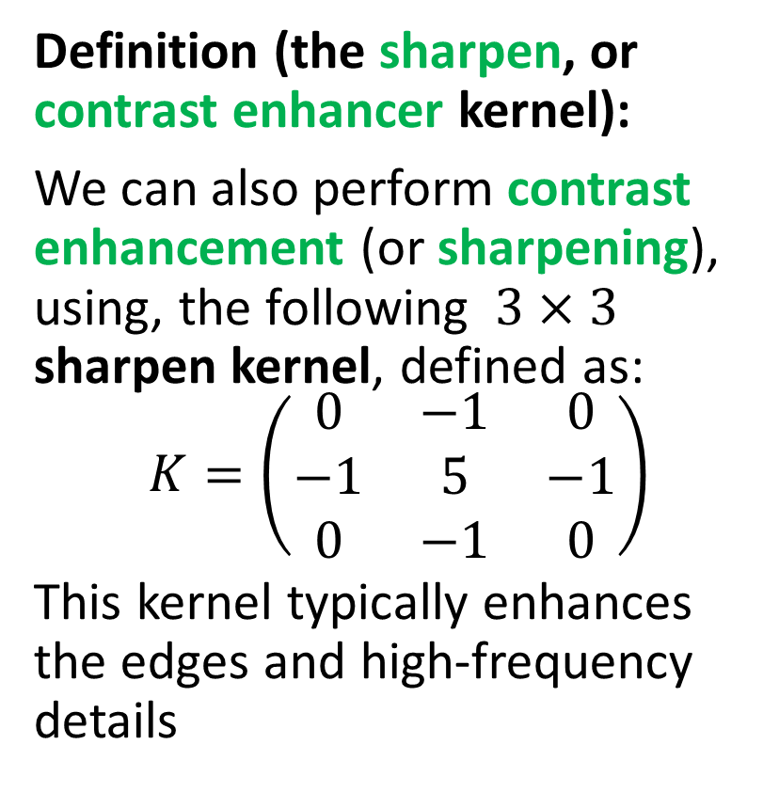
Testing convolution on images
Definition (the sharpen, or contrast enhancer kernel):
We can also perform contrast enhancement (or sharpening), using, the following $3×3$ sharpen kernel, defined as:
$$K=\left(\begin{matrix}0 & −1 & 0 \\ −1 & 5 & −1 \\ 0 & −1 & 0\end{matrix}\right)$$
This kernel typically enhances the edges and high-frequency details

Slide 37
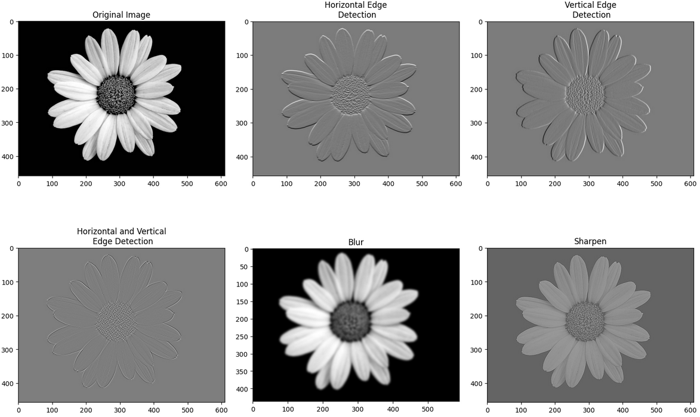
Many transformation kernels exist

Slide 38
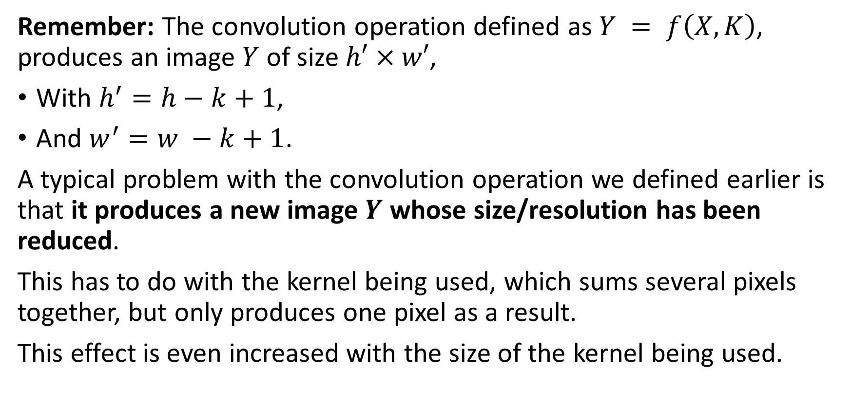
Downsizing
Remember: The convolution operation defined as $Y = f\left(X, K\right)$, produces an image $Y$ of size $h′×w′$,
With $h^{′}=h−k+1$,
And $w^{′}=w −k+1$.
A typical problem with the convolution operation we defined earlier is that it produces a new image $Y$ whose size/resolution has been reduced.
This has to do with the kernel being used, which sums several pixels together, but only produces one pixel as a result.
This effect is even increased with the size of the kernel being used.

Slide 39
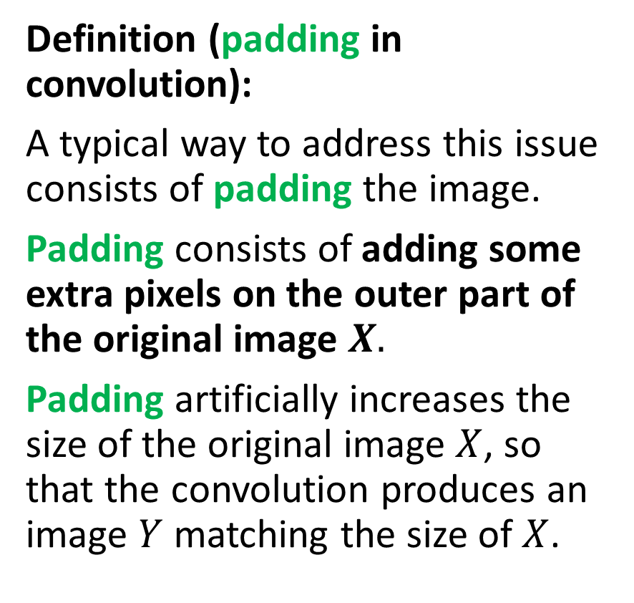
Adding some padding
Definition (padding in convolution):
A typical way to address this issue consists of padding the image.
Padding consists of adding some extra pixels on the outer part of the original image $X.$
Padding artificially increases the size of the original image $X$, so that the convolution produces an image $Y$ matching the size of $X$.
Three possible patterns for padding exist:
Valid/Same padding,
Zero padding,
Other types of padding…
This is typically be used to maintain the spatial dimensions of the input image and prevent the spatial dimensions of the output from getting too small.

Slide 40


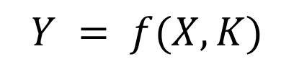

Adding some padding
Valid padding: default configuration, no padding is applied to the input data. The convolution operation is only performed only on the valid parts of the input and the output size is then smaller than the input size.
$$Y = f(X, K)$$
$$K$$
$$Y$$
$$X$$

Slide 41
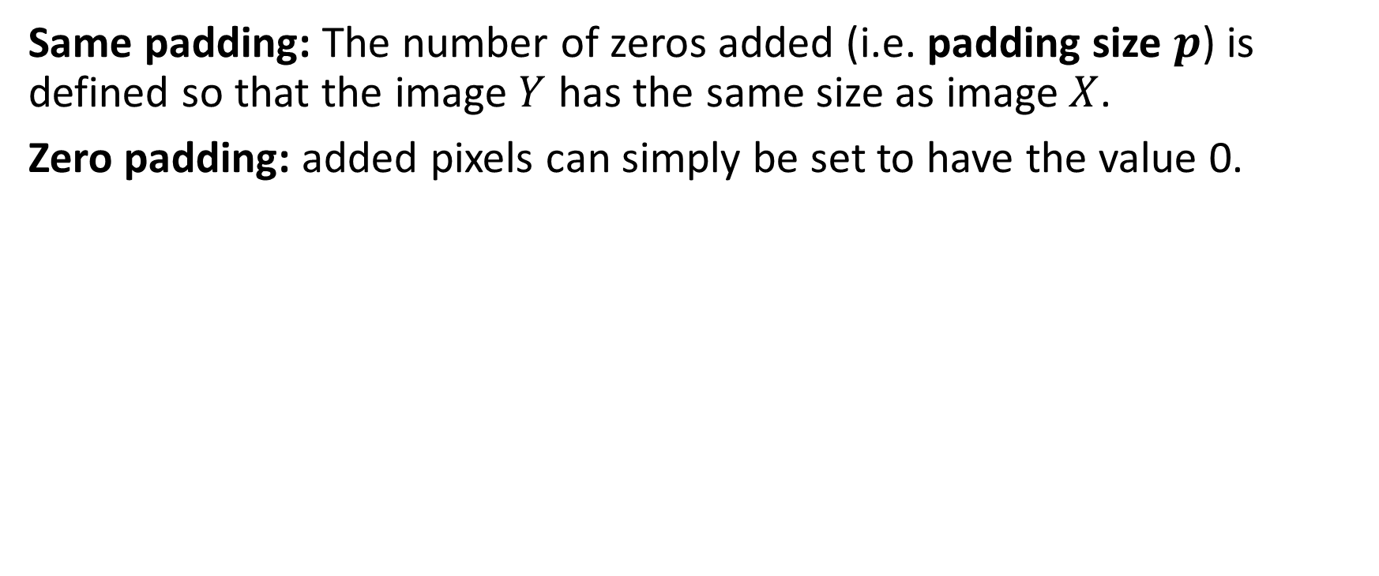
Adding some padding
Same padding: The number of zeros added (i.e. padding size $p$) is defined so that the image $Y$ has the same size as image $X$.
Zero padding: added pixels can simply be set to have the value 0.
0 | 0 | 0 | 0 | 0 | 0 | 0
0 |  |  |  |  |  | 0
0 |  |  |  |  |  | 0
0 |  |  |  |  |  | 0
0 |  |  |  |  |  | 0
0 |  |  |  |  |  | 0
0 | 0 | 0 | 0 | 0 | 0 | 0
$$Y = f(X, K)$$
$$K$$
$$Y$$
$$X$$

Slide 42
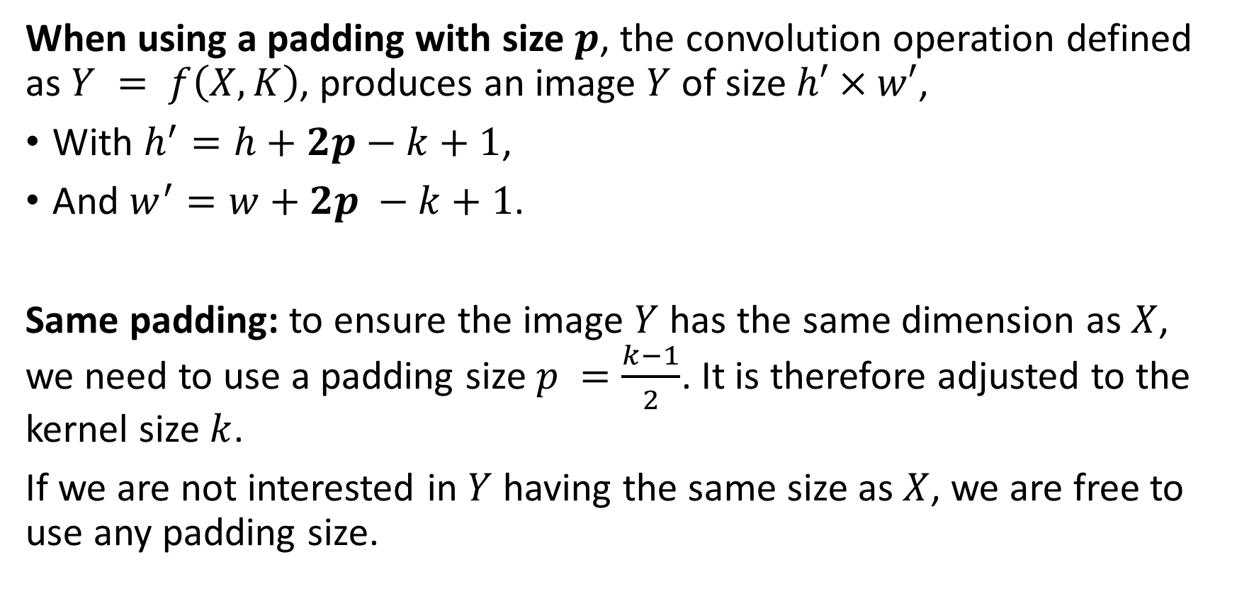
Adding some padding
When using a padding with size $p$, the convolution operation defined as $Y = f\left(X, K\right)$, produces an image $Y$ of size $h′×w′$,
With $h^{′}=h+2p−k+1$,
And $w^{′}=w+2p −k+1$.
Same padding: to ensure the image $Y$ has the same dimension as $X$, we need to use a padding size $p =\frac{k−1}{2}$. It is therefore adjusted to the kernel size $k$.
If we are not interested in $Y$ having the same size as $X$, we are free to use any padding size.

Slide 43
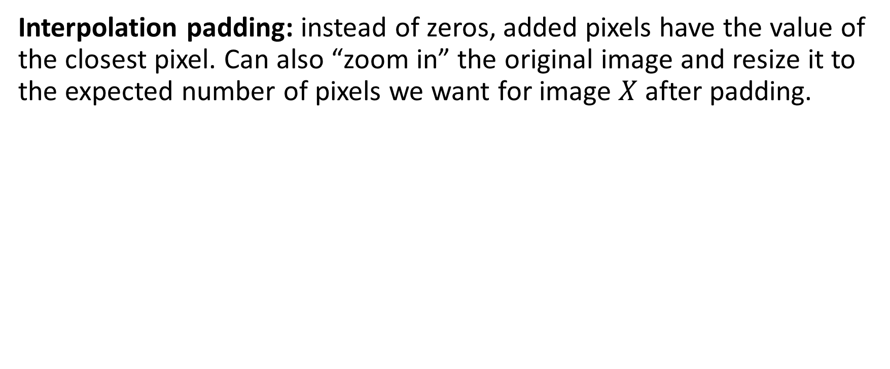
Adding some padding
Interpolation padding: instead of zeros, added pixels have the value of the closest pixel. Can also “zoom in” the original image and resize it to the expected number of pixels we want for image $X$ after padding.
1 | 1 | 5 | 5 | 2 | 4 | 4
1 | 1 | 5 | 5 | 2 | 4 | 4
2 | 2 | 4 | 5 | 2 | 2 | 2
3 | 3 | 1 | 1 | 1 | 1 | 1
4 | 4 | 4 | 7 | 2 | 3 | 3
5 | 5 | 0 | 0 | 3 | 1 | 1
5 | 5 | 0 | 0 | 0 | 1 | 1
$$Y = f(X, K)$$
$$K$$
$$Y$$
$$X$$

Slide 44
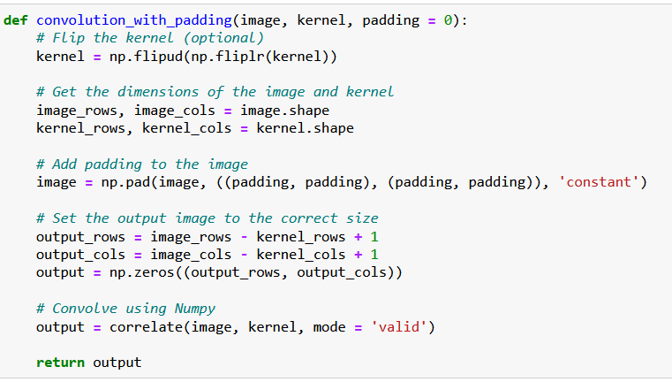
Adding some padding
Padding is simply implemented using the pad() functions,
It adds a layer of zeroes to the matrix image, of size padding on top, bottom, right and left side of the image matrix.

Slide 45
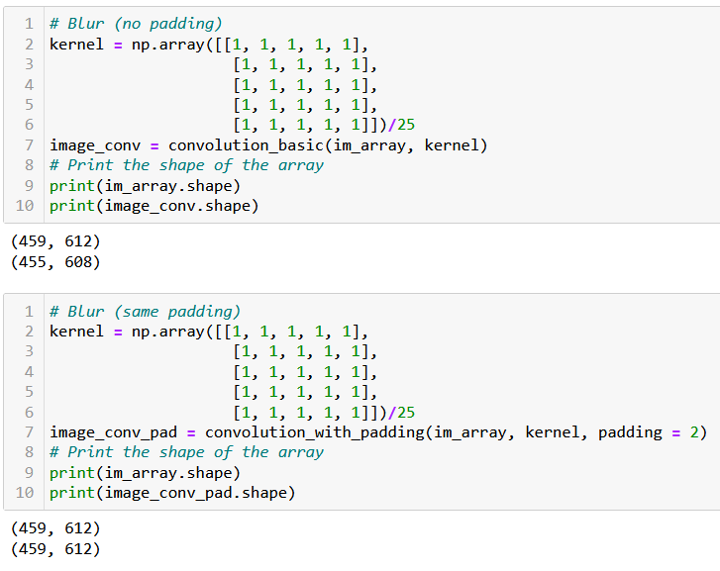
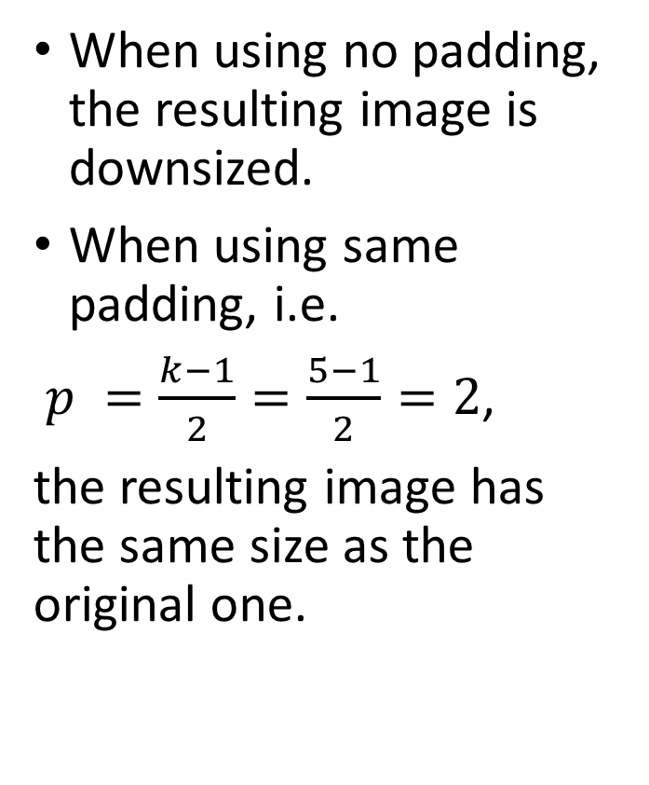
Adding some padding
When using no padding, the resulting image is downsized.
When using same padding, i.e.
$p =\frac{k−1}{2}=\frac{5−1}{2}=2$,
the resulting image has the same size as the original one.

Slide 46
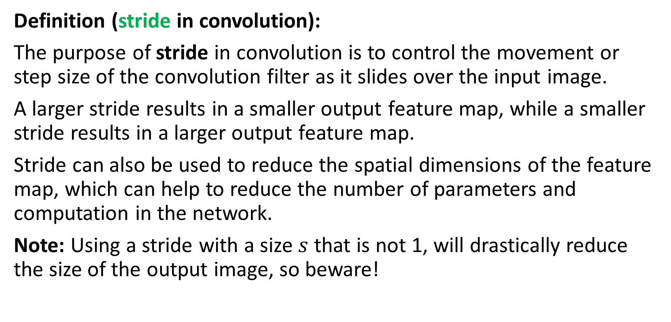
Adding a stride
Definition (stride in convolution):
The purpose of stride in convolution is to control the movement or step size of the convolution filter as it slides over the input image.
A larger stride results in a smaller output feature map, while a smaller stride results in a larger output feature map.
Stride can also be used to reduce the spatial dimensions of the feature map, which can help to reduce the number of parameters and computation in the network.
Note: Using a stride with a size $s$ that is not 1, will drastically reduce the size of the output image, so beware!

Slide 47
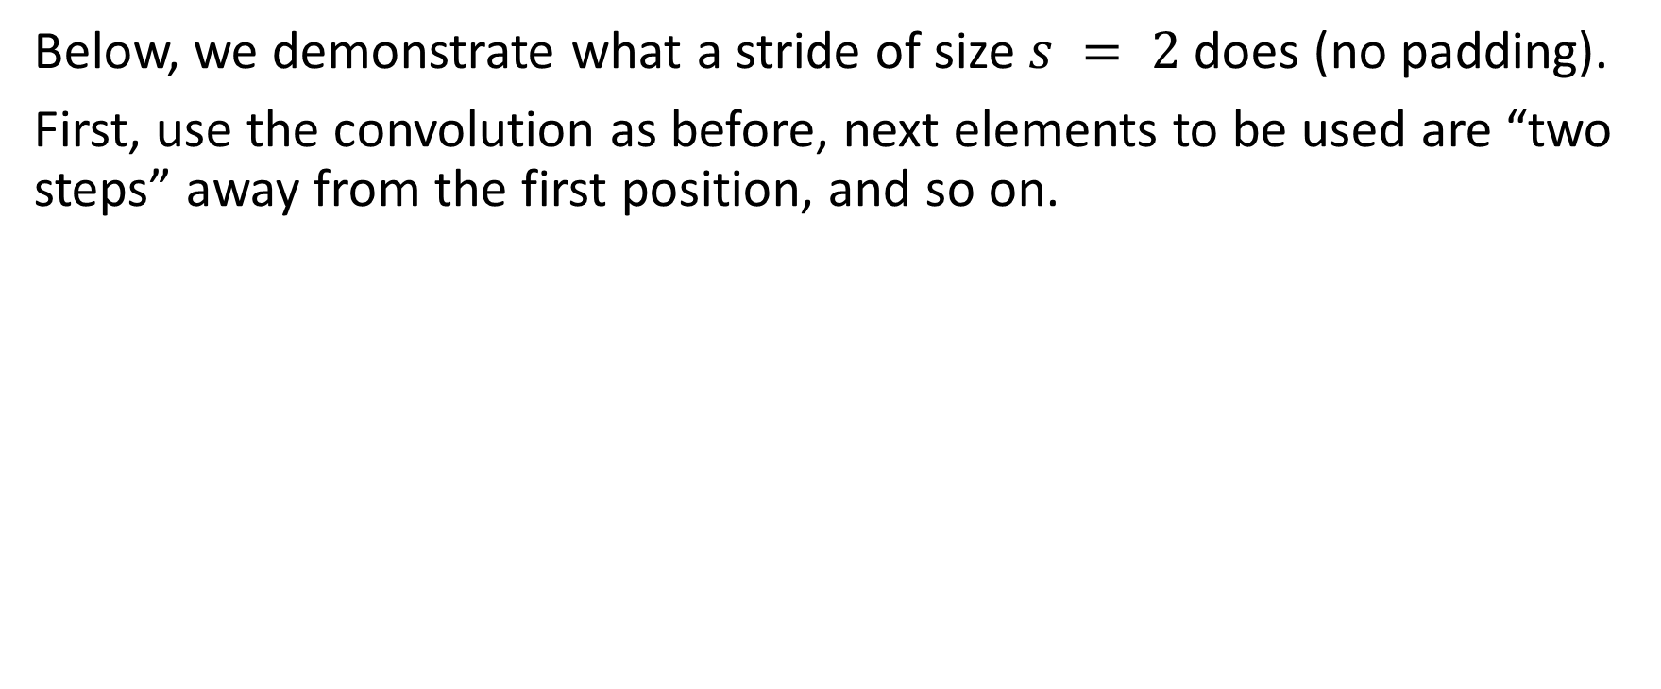
Adding a stride
Below, we demonstrate what a stride of size $s = 2$does (no padding).
First, use the convolution as before, next elements to be used are “two steps” away from the first position, and so on.
1 | 1 | 5 | 5 | 2 | 4 | 4
1 | 1 | 5 | 5 | 2 | 4 | 4
2 | 2 | 4 | 5 | 2 | 2 | 2
3 | 3 | 1 | 1 | 1 | 1 | 1
4 | 4 | 4 | 7 | 2 | 3 | 3
5 | 5 | 0 | 0 | 3 | 1 | 1
5 | 5 | 0 | 0 | 0 | 1 | 1
…
$$Y = f(X, K)$$
$$K$$
$$Y$$
$$X$$

Slide 48
Adding a stride
Below, we demonstrate what a stride of size $s = 2$does (no padding).
First, use the convolution as before, next elements to be used are “two steps” away from the first position, and so on.
1 | 1 | 5 | 5 | 2 | 4 | 4
1 | 1 | 5 | 5 | 2 | 4 | 4
2 | 2 | 4 | 5 | 2 | 2 | 2
3 | 3 | 1 | 1 | 1 | 1 | 1
4 | 4 | 4 | 7 | 2 | 3 | 3
5 | 5 | 0 | 0 | 3 | 1 | 1
5 | 5 | 0 | 0 | 0 | 1 | 1
… | …
$$Y = f(X, K)$$
$$K$$
$$Y$$
$$X$$

Slide 49
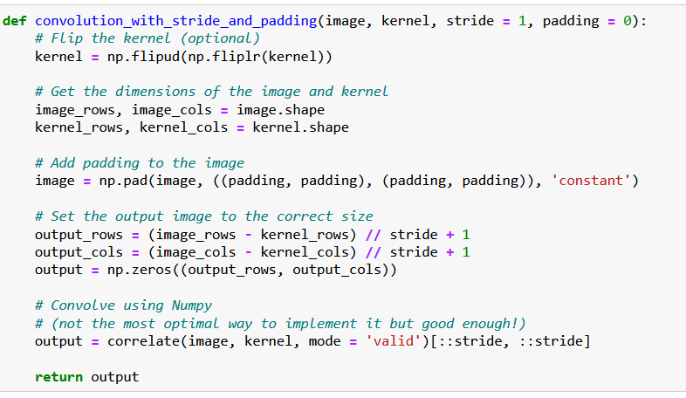
Adding a stride
Stride is easily implemented by using a slicing in the result of the correlation.
This is not the most optimized way to do it, however!
(We do not care so much, as we will use the PyTorch version of convolution after this!)

Slide 50
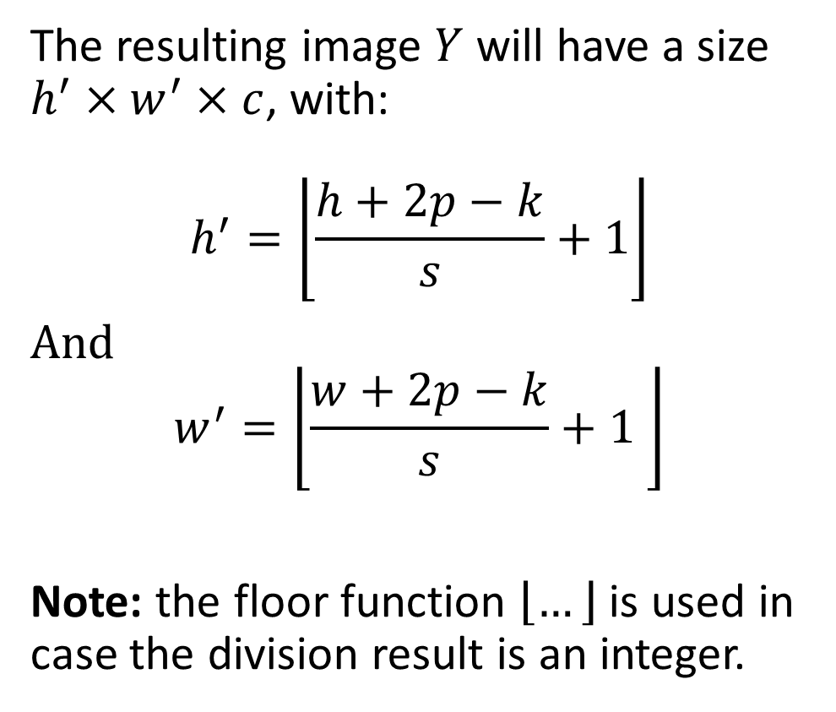
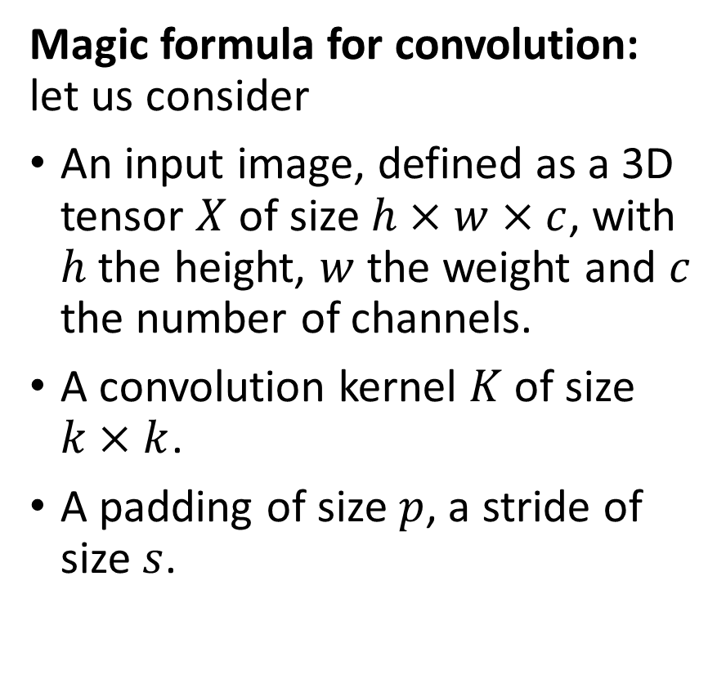
The (final) magic formula for convolution
Magic formula for convolution: let us consider
An input image, defined as a 3D tensor $X$ of size $h×w×c$, with $h$ the height, $w$ the weight and $c$ the number of channels.
A convolution kernel $K$ of size $k×k$.
A padding of size $p$, a stride of size $s$.
The resulting image $Y$ will have a size $h^{′}×w^{′}×c$, with:
$$h^{′}=\left\lfloor \frac{h+2p−k}{s}+1\right\rfloor$$
And $$w^{′}=\left\lfloor \frac{w+2p−k}{s}+1 \right\rfloor$$
Note: the floor function $\left\lfloor …\right\rfloor$ is used in case the division result is an integer.

Slide 51
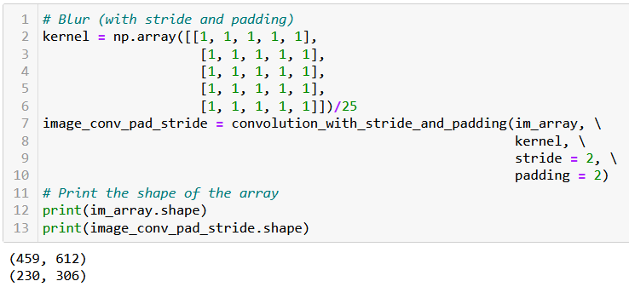
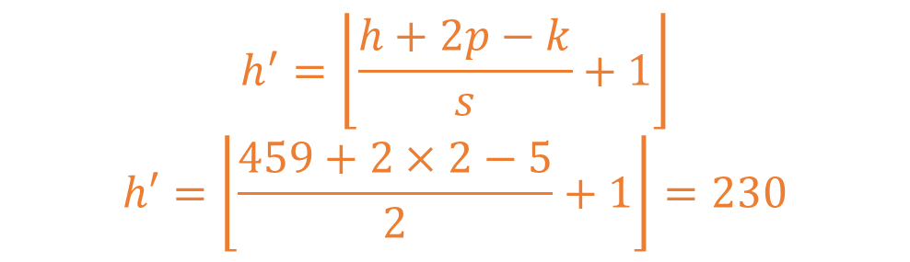
Adding a stride
$$h^{′}=\left\lfloor \frac{h+2p−k}{s}+1\right\rfloor$$
$$h′=\left\lfloor \frac{459+2×2−5}{2}+1\right\rfloor =230$$

Slide 52
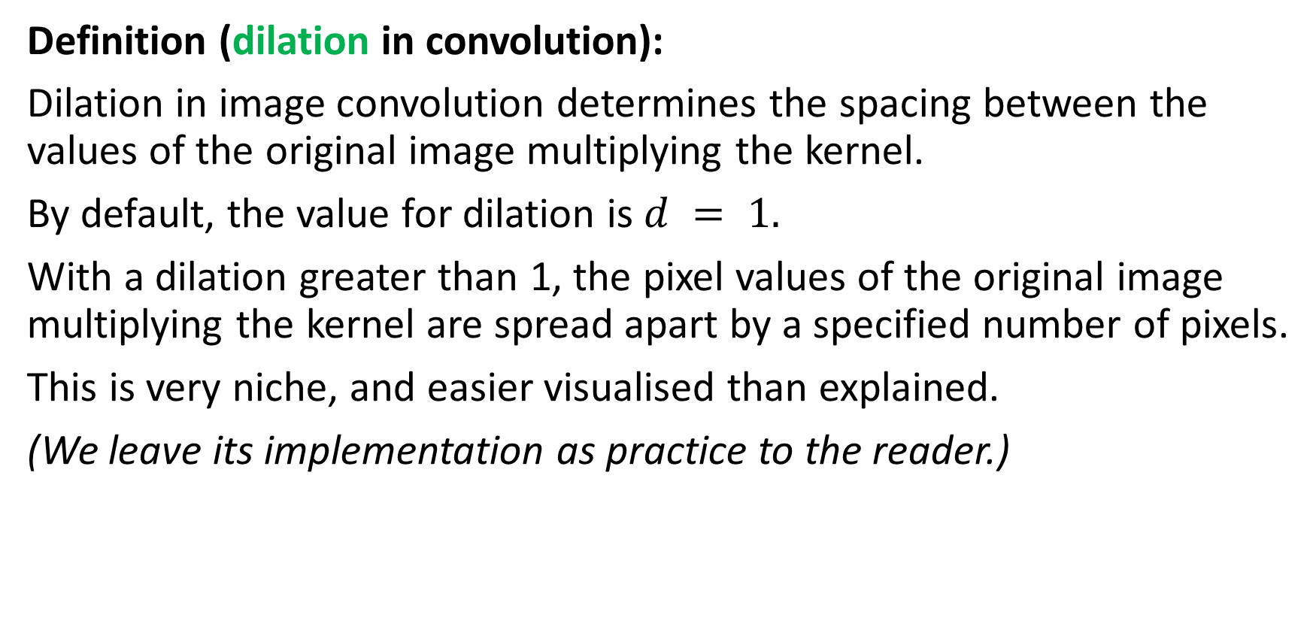
Adding a dilation
Definition (dilation in convolution):
Dilation in image convolution determines the spacing between the values of the original image multiplying the kernel.
By default, the value for dilation is $d = 1.$
With a dilation greater than 1, the pixel values of the original image multiplying the kernel are spread apart by a specified number of pixels.
This is very niche, and easier visualised than explained.
(We leave its implementation as practice to the reader.)

Slide 53
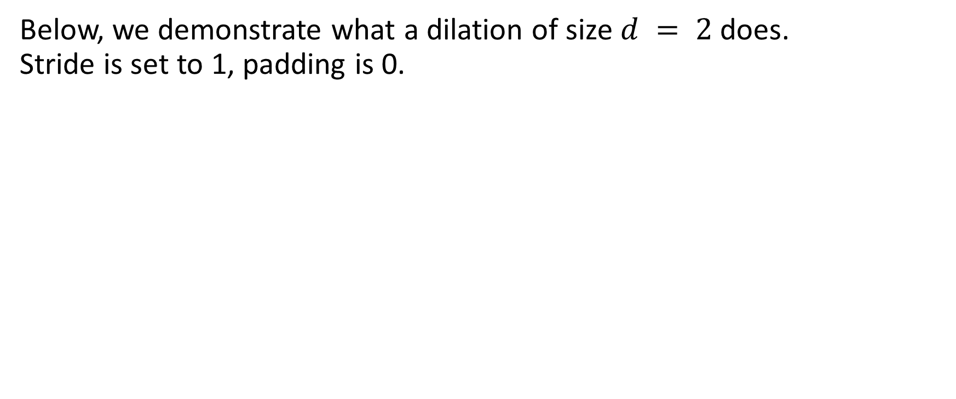
Adding a dilation
Below, we demonstrate what a dilation of size $d = 2$does. Stride is set to 1, padding is 0.
1 | 1 | 5 | 5 | 2 | 4 | 4
1 | 1 | 5 | 5 | 2 | 4 | 4
2 | 2 | 4 | 5 | 2 | 2 | 2
3 | 3 | 1 | 1 | 1 | 1 | 1
4 | 4 | 4 | 7 | 2 | 3 | 3
5 | 5 | 0 | 0 | 3 | 1 | 1
5 | 5 | 0 | 0 | 0 | 1 | 1
…
$$Y = f(X, K)$$
$$K$$
$$Y$$
$$X$$

Slide 54
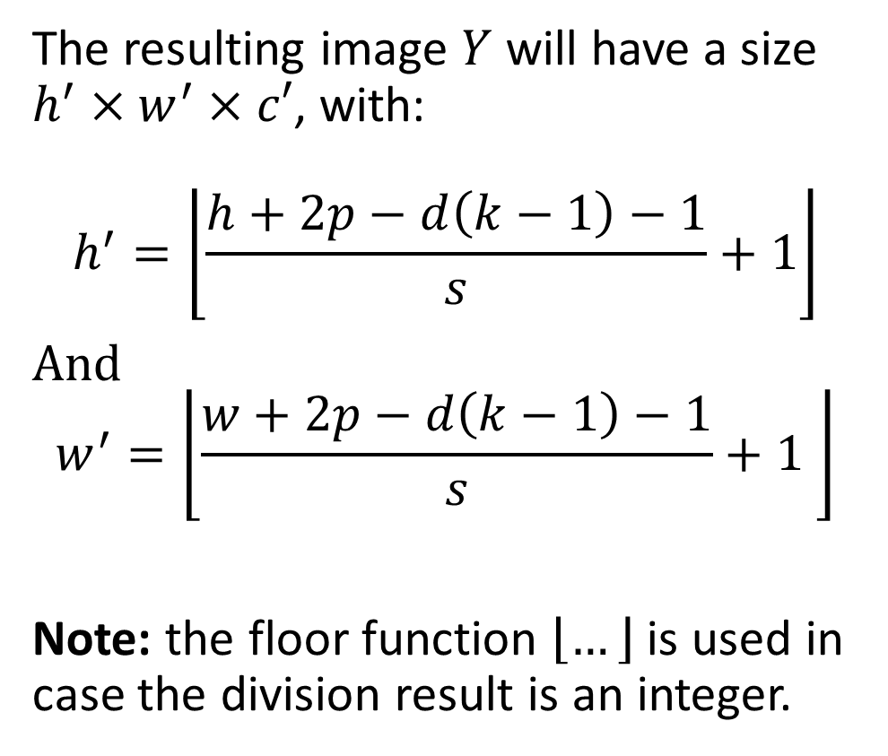
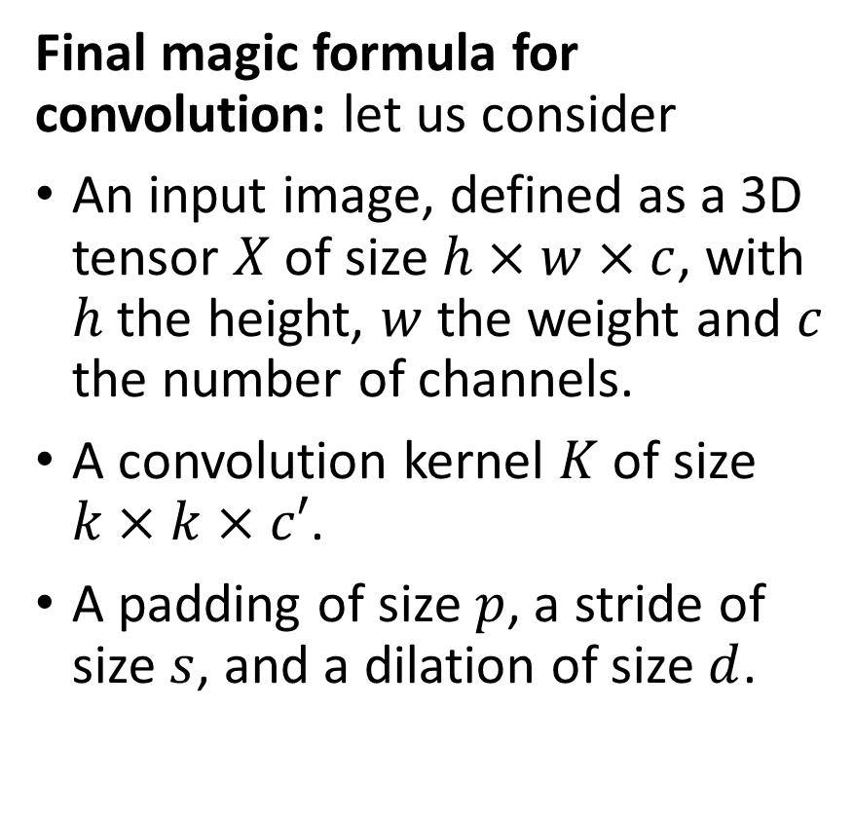
The (final) magic formula for convolution
Final magic formula for convolution: let us consider
An input image, defined as a 3D tensor $X$ of size $h×w×c$, with $h$ the height, $w$ the weight and $c$ the number of channels.
A convolution kernel $K$ of size $k×k×c′$.
A padding of size $p$, a stride of size $s$, and a dilation of size $d$.
The resulting image $Y$ will have a size $h^{′}×w^{′}×c′$, with:
$$h^{′}=\left\lfloor \frac{h+2p−d\left(k−1\right)−1}{s}+1\right\rfloor$$
And $$w^{′}=\left\lfloor \frac{w+2p−d\left(k−1\right)−1}{s}+1 \right\rfloor$$
Note: the floor function $\left\lfloor …\right\rfloor$ is used in case the division result is an integer.

Slide 55
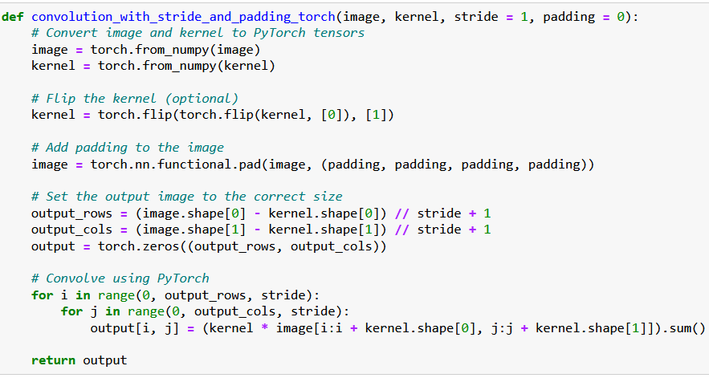
Implementing a custom Conv in PyTorch

Slide 56
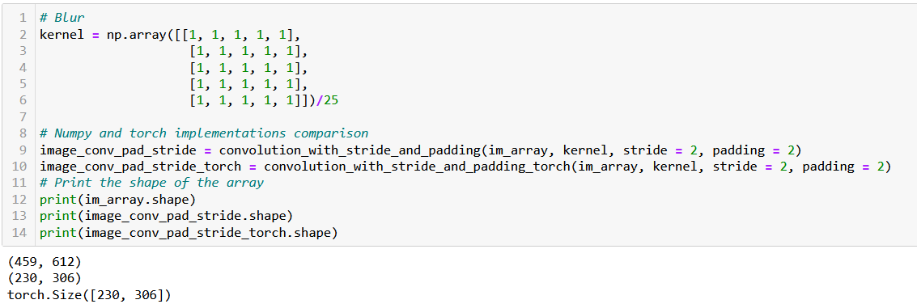
Implementing a custom Conv in PyTorch
The PyTorch and the Numpy implementations are indeed equivalent.

Slide 57
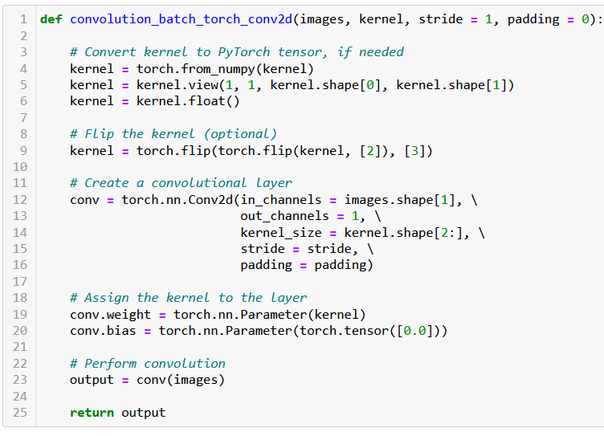
The Conv2d in PyTorch
PyTorch has a Conv2d function implementing said convolution.
We will rely on it from now on.

Slide 58
The Conv2d in PyTorch
Note, however that this layer has two trainable parameters:
Weight (which is our kernel, whose values will be decided later during training).
Bias (which was not there before?)

Slide 59

The Conv2d in PyTorch
Note, however that this layer has two trainable parameters:
Weight (which is our kernel, whose values will be decided later during training).
Bias (which was not there before?)
Bias is simply added to our convolution operation, following the intuition of the $WX + b$operation from earlier.
$$Y_{i,j}=\frac{1}{k^{2}}\sum_{m=1}^{k}{\sum_{n=1}^{k}{X_{i+m−1, j+n−1} K_{m,n}}}+b$$

Slide 60

The Conv2d in PyTorch
In the PyTorch Conv2d operations however, the input images $X$ need to be formatted as a 4D tensor of size $N_{s}×c×h×w$, with
$N_{s}$, the number of samples/images in batch of data $X$,
$c$ , the number of channels in images of batch $X$ (e.g. greyscale = 1, RGB = 3),
$h$ , the height for images batch of data $X$,
$w$ , the width for images batch of data $X$.
Same thing for the kernel

Slide 61

The Conv2d in PyTorch
This is the reason for reshaping the kernel
from a 2D NumPy array of size $\left(k, k\right)$,
to a 4D PyTorch tensor of size $(1, 1, k, k)$.
And eventually flipping the kernel along the last two dimensions.

Slide 62


If we use the MNIST dataloader…
MNIST dataloader will give batches of data as 4D tensors of shape $N_{s}×c×h×w$, with:
$N_{s}$, being batch size (here, 256),
$c$ , the number of channels (here, 1),
$h$ , the height for images (here, 28),
$w$ , the height for images (here, 28).

Slide 63

If we use the MNIST dataloader…
Not using a padding, stride 1, and kernel size is 5.
Our magic formula from earlier then gives:
$$28+ 2×0−5+1=24.$$

Slide 64
A quick word on higher dimensions
So far, we have implemented the convolution operation on images that were greyscale (either our flower image or the MNIST dataset).
What happens when playing with higher dimension images, i.e. images that have more than one channel (e.g. RGB)?

Slide 65




Convolution on high dim
1 | 2 | 4 | 2 | 1
4 | 7 | 3 | 2 | 1
4 | 5 | 2 | 3 | 1
2 | 1 | 7 | 8 | 4
3 | 2 | 4 | 7 | 8
1 | 2 | 4 | 2 | 1
4 | 7 | 3 | 2 | 1
4 | 5 | 2 | 3 | 1
2 | 1 | 7 | 8 | 4
3 | 2 | 4 | 7 | 8
1 | 2 | 4 | 2 | 1
4 | 7 | 3 | 2 | 1
4 | 5 | 2 | 3 | 1
2 | 1 | 7 | 8 | 4
3 | 2 | 4 | 7 | 8
$$X$$
In the case of RGB images, the resulting matrix $Y$ is then of size $h^{′}×w^{′}×3$.
The pixel values $y_{i,j, l}$for image $Y$ are calculated using the convolution operation, on each channel separately.
We then define pixels $Y_{i,j,l}$, $∀i∈\left[1, h^{′}\right], j∈\left[1,w^{′}\right], ∀l∈[1, 3]$:
$$Y_{i,j,l}=\frac{1}{k^{2}}\sum_{m=1}^{k}{\sum_{n=1}^{k}{X_{i+m−1, j+n−1,l} K_{m,n}}}+b$$
1 | 0 | 1
0 | 2 | 1
1 | 0 | 1
$$K$$
$$…$$ | … | …
… | … | …
… | $$\frac{39}{9}$$ | …
$$…$$ | … | …
… | … | …
… | $$\frac{39}{9}$$ | …
$$Y$$
$$\frac{28}{9}$$ | … | …
… | … | …
… | $$\frac{39}{9}$$ | …
This operation preserves the original number of channels of original image $X$, producing a new RGB image $Y$ as a result.

Slide 66






Convolution on high dim
1 | 2 | 4 | 2 | 1
4 | 7 | 3 | 2 | 1
4 | 5 | 2 | 3 | 1
2 | 1 | 7 | 8 | 4
3 | 2 | 4 | 7 | 8
1 | 2 | 4 | 2 | 1
4 | 7 | 3 | 2 | 1
4 | 5 | 2 | 3 | 1
2 | 1 | 7 | 8 | 4
3 | 2 | 4 | 7 | 8
1 | 2 | 4 | 2 | 1
4 | 7 | 3 | 2 | 1
4 | 5 | 2 | 3 | 1
2 | 1 | 7 | 8 | 4
3 | 2 | 4 | 7 | 8
$$X$$
More generally, however: if you define the kernel as a tensor with its own number of channels $k_{d}≠1$…
We then define pixels $Y_{i,j,l}$, $∀i∈\left[1, h^{′}\right], j∈\left[1,w^{′}\right], ∀l∈[1, k_{d}]$:
$$Y_{i,j,l}=\frac{1}{k^{2}}\sum_{m=1}^{k}{\sum_{n=1}^{k}{\sum_{l^{′}=1}^{3}{X_{i+m−1, j+n−1,l^{′}} K_{m,n,l}}}}+b$$
This operation will then produce a new image $Y$, whose number of channels matches the one of the kernel $K$, as a result, i.e. $h^{′}×w^{′}×k_{d}$.
1 | 0 | 1
0 | 2 | 1
1 | 0 | 1
1 | 0 | 1
0 | 2 | 1
1 | 0 | 1
$$K$$
1 | 0 | 1
0 | 2 | 1
1 | 0 | 1
$$…$$ | … | …
… | … | …
… | $$\frac{39}{9}$$ | …
$$…$$ | … | …
… | … | …
… | $$\frac{39}{9}$$ | …
$$Y$$
$$\frac{28}{9}$$ | … | …
… | … | …
… | $$\frac{39}{9}$$ | …

Slide 67


Conv2d layer
Definition (the Conv2d layer):
The Conv2d layer is PyTorch’s implementation of the convolution operation we have seen earlier.
The first two integer values correspond to the number of channels of input images $X$ and the number of channels in kernel.
The convolution layer below then expects grayscale images $X$ with only one channel and will produce images $Y$ with 32 channels.
→ What is this image with 32 channels?

Slide 68

Convolution on high dim
→ What is this image with 32 channels?
We could visualize that as 32 convolutions operations on our grayscale images $X$, being run on parallel with 32 different kernels.
Kernels could correspond to different operations (blur, sharpen, edge detection, etc.).

Slide 69

Chaining convolutions
→ What is this image with 32 channels?
We could visualize that as 32 convolutions operations on our grayscale images $X$, being run on parallel with 32 different kernels.
Kernels could correspond to different operations (blur, sharpen, edge detection, etc.).
Eventually chaining several convolutions, will lead to combining operations together.

Slide 70

Chaining convolutions
For instance: recognizing a cat ear = two edge detections, then combined to recognize a triangular shape or some sort?

Slide 71
The core idea behind CNN
Definition (Convolutional Neural Networks):
Introduced in [LeCun1998], Convolutional Neural Networks (or CNNs in short) are Neural Networks which integrate convolutions as the processing operations to be used on input images, in place of the Linear ones.
Training a CNN is then equivalent to letting the Neural Network decide on which kernels values (and therefore image processing operations) to use in the convolution operations run in both parallel and sequence.

Slide 72
Training a CNN
CNNs have shown much better performance at processing images data types, compared to Neural Networks implementing Linear operations only.
For this reason, Convolutions (and CNNs) are indeed the preferred processing method when inputs are images.
In addition, as the convolution is “just another weird matrix multiplication of some sort”, this means that the trainable parameters (weight/kernel and bias) could be trained using the same backpropagation as earlier!
(We will however not implement it and rely on autograd!)

Slide 73
Chaining convolutions
For instance: recognizing a cat ear = two edge detections, then combined to recognize a triangular shape or some sort?

Slide 74



Chaining convolutions
Week 12-13 (explainability on CNNs): We will show during this lecture how the first layers are typically implementing basic shapes and colors detection, whereas deeper layers are progressively recognizing more and more sophisticated patterns.

Slide 75
Our first CNN on MNIST
We will therefore build our first Convolutional Neural Network (CNN).
This network will have the same logic as the previous DNN from last week, but it will replace the first few Linear layers with Conv2d operations instead.
By doing so, we are hoping that the CNN will be able to figure out which kernel values (and image processing operations) to use, for the MNIST classification task.
The final layers must consist of Linear layers, whose purpose is to eventually produce a vector of 10 values, probabilities for each class.
Between the last Conv2d (which produces a 2D image) and the first fully connected vector (which expects a 1D vector), we will implement a flattening of the image, as before.

Slide 76
Our first CNN on MNIST
Our CNN: 2 Conv2d layers + Flatten + 2 Linear layers
Batch of 256 greyscale MNIST images (256, 1, 28, 28)
First Conv2d, with same padding (256, 32, 28, 28)
Second Conv2d, with same padding (256, 64, 28, 28)
Flatten in 1D vector (256, 50176)
First Linear Layer (256, 128)
Second Linear Layer (256, 10)

Slide 77

Our first CNN on MNIST
Our CNN: 2 Conv2d layers + Flatten + 2 Linear layers

Slide 78

Our first CNN on MNIST
Our CNN: 2 Conv2d layers + Flatten + 2 Linear layers
Define the sequence of operations in the forward method as before.
Good practice: We will print the shape of each layer output to confirm sizes produced by each layer.

Slide 79


Our first CNN on MNIST
Good practice: We will show the modules/layers in our CNN, and print the shape of each layer output to confirm sizes produced by each layer.

Slide 80
Writing a trainer function for CNNs
As before, we need a trainer and evaluation function for our CNN model.
We will be using a stochastic mini-batch Adam optimizer, like before.
Loss is cross entropy, like before.
We will keep track of the train/test losses, train/ test accuracies, and display them in training performance curves later.
Over a given number of iterations, using the power of the backward() and optimizer.step() methods to update parameters automatically for us in all the Conv2d and Linear layers.
We will then set the model on eval mode and compute losses and accuracies on the testing set, one final time.

Slide 81

Trainer/Eval function (setup)

Slide 82
Trainer/Eval function (training part)

Slide 83

Trainer/Eval function (evaluation part)

Slide 84

Trainer/Eval function (running)

Slide 85

Trainer/Eval function (running)
In only three iterations, we manage to achieve a higher accuracy than the equivalent Linear model we have trained last week!
Confirmed!
CNNs and Convolution operations are indeed better than Linear operations when it comes to processing images!

Slide 86
Pooling layers
Definition (pooling layers):
A pooling layer in a CNN is a down-sampling operation that strongly reduces the spatial dimensions (width and height) of the successive images or feature maps, while retaining the important information.
The purpose of pooling is to reduce the computation and memory required by the network, as well as to increase the invariance of the features with respect to small translations (from the same paper, [LeCun1998]).
A pooling layer, like the flattening operation, does not have any trainable parameters, and is therefore not a trainable layer.

Slide 87

Types of pooling layers
In PyTorch, there are different types of pooling layers, all worth trying, including:
Max pooling: Selects the maximum value from the window,
Average pooling: Takes the average of all values,
Sum pooling: Takes the sum of all values in the window.
Etc.

Slide 88

Types of pooling layers

Slide 89


Slide 90

Dropout layers
Definition (dropout layers):
Introduced in [Srivastava2014], the dropout layer is a regularization technique used in deep learning to prevent overfitting.
The dropout layer randomly drops out, or sets to zero, some of the neurons in the network during each training iteration.

Slide 91

Dropout layers
Definition (dropout layers):
Introduced in [Srivastava2014], the dropout layer is a regularization technique used in deep learning to prevent overfitting.
The dropout layer randomly drops out, or sets to zero, some of the neurons in the network during each training iteration.
In PyTorch, dropout is applied using the nn.Dropout module, and it is typically inserted
after a linear or convolutional layer,
and before a non-linear activation function.
The nn.Dropout takes one argument: the probability $p$ of an element to be zeroed.

Slide 92

Dropout layers
E.g. using $p = 0.5$ means that during the forward pass, half of the neurons will be set to zero.
The Dropout layer is not trainable as the parameter $p$ is to be manually decided, usually with a value between 0.1 and 0.5.
It is therefore another hyperparameter to take into account!

Slide 93
A very important note, however: Dropout is the first operation we see to have two different behaviours.
During training mode (i.e. when model is set to train() mode), the dropout layer randomly drops out a specified portion of the neurons, as said earlier.
During evaluation mode (i.e. when model is set to eval() mode), it does not drop out any neurons anymore. Instead, it passes all activations from the previous layer to the next layer in the network, in an attempt to maximize performance on the test set.

Slide 94

Batchnorm layer
Definition (the batchnorm layer):
Batch normalization (or batchnorm) is a technique used to improve the stability and performance of neural networks. It was presumably introduced in [Ioffe2015].
It normalizes the activations produced by each layer for each mini-batch. The purpose of batchnorm is to reduce internal covariate shift, which refers to the change in the distribution of network activations due to the change in network parameters during training.
This can make the training process faster and more stable.
$≈$ Reuses the same intuition as to why inputs in datasets should be normalized, but applies it to the inputs of all layers in network.

Slide 95
Batchnorm layer
In PyTorch, batchnorm can be applied to a layer using the nn.BatchNorm2d or nn.BatchNorm1d module, depending on whether the data is 1D shaped (output of a linear layer) or 2D shaped (e.g. image output of a Convolutional layer)
Like the dropout, the module should be inserted
after a linear or convolutional layer in the network,
and before the non-linear activation function.
The batchnorm layer takes one argument: the number of channels in the output of the previous layer.

Slide 96

Normalization in BatchNorm
The equation for batch normalization (batchnorm) is as follows:
$$y =\frac{γ\left(x − μ\right)}{σ} + β$$
Where:
$x$ (resp. $y$) is the input (resp. output) to the batchnorm layer,
$μ$ and $σ$ are the mean and standard deviation of the batch, respectively, and are calculated separately for each feature dimension in the input batch $x$.
$γ$ and $β$ are trainable parameters for the batchnorm layer, also known as scale and shift parameters.

Slide 97

Normalization in BatchNorm

Slide 98
About BatchNorm behaviours
Important: BatchNorm, just like Dropout has two different behaviours in train and eval modes.
When the network is in training mode, the batch normalization layer updates its mean and variance estimates based on the current mini-batch of data. During the forward pass, it applies the normalization based on these mean and variance estimates.
When the network is in evaluation mode, the batch normalization layer uses the mean and variance estimates calculated during training to normalize the activations. This ensures that the activations are normalized in the same way during training and evaluation.

Slide 99

Implementing all layers in our CNN
Let us first define Batchnorm, dropout and maxpool layers in __init__.
Arbitrarily fixing the dropout probabilities (should be hyperparameter?).

Slide 100

Implementing all layers in our CNN
Using each layer in correct sequence of the forward() method.
Also, one MaxPool layer after last Conv2d.
64*14*14 instead of 64*28*28 in Flatten due to MaxPool

Slide 101

Implementing all layers in our CNN

Slide 102
A final note
The Dropout, Batchnorm and Pooling layers have been introduced in the Computer Vision field.
However, these days, every other field of Deep Learning (e.g. Natural Language Processing) is reusing them in their own models.
Important lesson: you might not necessarily be interested in Computer Vision, but you should still consider learning about it, as many intuitions and tools could be reused in other problems.

Slide 103
A quick word about Data Augmentation
Definition (Data Augmentation):
Data augmentation is a technique used to artificially increase the size of the training dataset by applying various transformations to the existing data.
This helps to expose the model to more variations of the data, making it more robust and less prone to overfitting (according to [Krizhevsky2012]).
More specifically, the model can then learn to recognize patterns and features that are supposed to be invariant to certain changes, such as translations, rotations, and scaling.
Data augmentation can also be used to correct imbalance in the distribution of classes by artificially increasing the number of examples of the under-represented classes (e.g. if you have many pictures of 2s and few 6s), or when the amount of available training data is limited.

Slide 104
Some examples of data augmentation/transform
Some possible ways to perform data augmentation include:
Randomly translating images by a certain number of pixels,
Randomly rotating the images by a small angle,
Randomly scaling the images by a small factor,
Randomly cropping the images,
Randomly flipping the images horizontally/vertically,
Adding random noise to the images,
Randomly changing the brightness or contrast of the images,
Etc.

Slide 105
Some examples of data augmentation/transform
These can be accomplished by using pre-built data augmentation transforms such as RandomRotation, RandomAffine, RandomCrop, RandomHorizontalFlip, RandomGrayscale from the torchvision.transforms library or by using other libraries like imgaug, albumentations, etc.
Feel free to have a look at: https://pytorch.org/vision/stable/transforms.html
Additionally, you can also chain multiple transforms together using the Compose class from the torchvision.transforms library to apply multiple data augmentations at once.

Slide 106

Some examples of data augmentation/transform
For instance, if we want to flip images horizontally, we will simply amend the code below, adding RandomHorizontalFlip() to the list of transforms.
Quick question: Does it makes sense to perform this data augmentation on all pictures? Can all digits be flipped horizontally to generate new valid images?

Slide 107
Studying remarkable CV models
There are several reasons why it is important to learn about milestone computer vision models like AlexNet, Inception, ResNet, etc.
Understanding the history of computer vision and preparing for future advancements: gives appreciation for the progress that has been made in the field and how far it has come. See how each new model was an improvement upon the previous one and how each model paved the way for new advancements.
Understanding the key concepts and techniques: These milestone models introduced key concepts and techniques that are still widely used today, such as convolutional neural networks, residual connections, and transfer learning. By understanding these concepts and techniques, you will have a better understanding of how modern computer vision models work.

Slide 108
Studying remarkable CV models
Improving your skills: Studying these models can help you improve your skills as a practitioner of computer vision. You can learn how to implement these models and use them to solve real-world problems, as well as understand how to adapt and extend these models to fit your own needs (e.g. using a them on a slightly different dataset than the one they were initially trained on).
Overall, learning about milestone computer vision models is an important part of advancing your knowledge and skills in the field of computer vision.
We will now discuss, very briefly, some of these important milestone problems.
We strongly advise to pick the Term 7 Computer Vision course, to continue your learning!

Slide 109

The AlexNet model
Definition (The AlexNet model):
AlexNet is a model that competed in the "ImageNet Large Scale Visual Recognition Challenge" on September 30, 2012 ([Krizhevsky2012]).
It was trained on the ImageNet dataset, an image classification dataset consisting of $256× 256$RGB images (used as inputs), with 1000 classes (used as outputs).
AlexNet consists of a CNN model, similar to the one in Week4, Notebook 5. It was one of the first architectures to combine Conv2d layers with Dropout, Pooling and ReLU layers.
However, its main innovation at the time was the sheer number of layers and trainable parameters, and how the model had been trained on GPUs instead of CPU to improve the computational performance of the training.
The pre-trained model, with parameters defined as in 2012, can be loaded directly from PyTorch.

Slide 110

The AlexNet model

Slide 111


Slide 112
The VGG model
Definition (the VGG model):
VGG was based off of AlexNet, but it has several differences that separated it from other models ([]):
Instead of using 11x11 kernels with a stride of 4, VGG uses smaller 3x3 kernels with a stride of 1. It also uses three ReLU units instead of just one. For this reason, the decision function is more discriminative, and it has fewer parameters (27 times the number of channels, instead of AlexNet’s 49 times the number of channels).
VGG also incorporates 1x1 convolutional layers to make the decision function more non-linear without changing the receptive fields.
Having less parameters allows to have a larger number of layers, leading to improved performance.

Slide 113

The VGG model

Slide 114


Slide 115


Slide 116
The problem with very deep models
Very deep models, however, start to exhibit a problem…
Training the parameters on the first layers appears to be difficult…
For some reason, the gradients for the parameters of the first layer are close to zero (that is another instance of a vanishing gradient).

Slide 117

The problem with very deep models
Very deep models, however, start to exhibit a problem…
Training the parameters on the first layers appears to be difficult…
For some reason, the gradients for the parameters of the first layer are close to zero (that is another instance of a vanishing gradient).
Reason: using the chain rule many times in a row, multiplying partial derivatives with small values eventually leads to a very small, close to zero value for those partial derivatives.
$$\frac{∂L}{∂W_{1}}=\frac{∂L}{∂A_{25}}\frac{∂A_{25}}{∂A_{24}}…\frac{∂A_{1}}{∂W_{1}}$$
All have values in [-1,1]

Slide 118
The problem with very deep models
Very deep models, however, start to exhibit a problem…
Training the parameters on the first layers appears to be difficult…
For some reason, the gradients for the parameters of the first layer are close to zero (that is another instance of a vanishing gradient).
Reason: using the chain rule many times in a row, multiplying partial derivatives with small values eventually leads to a very small, close to zero value for those partial derivatives.
$$\frac{∂L}{∂W_{1}}=\frac{∂L}{∂A_{25}}\frac{∂A_{25}}{∂A_{24}}…\frac{∂A_{1}}{∂W_{1}}$$
Multiplication of all these values gives something close to 0
All have values in [-1,1]

Slide 119

Skip connections
Definition (skip connections):
Skip connections (or shortcut connections) refer to the direct connections between non-adjacent layers in a neural network architecture, bypassing one or more intermediate layers.
The purpose is to allow information to flow rapidly from the input of the network to its output, without being transformed or lost in the intermediate layers.

Slide 120
Skip connections
First, it enables the network to retain information from the input layer, which can be particularly useful in the case of deep neural networks, where the information can get transformed multiple times, hence losing its original information, as it passes through the hidden layers.
Second, skip connections are also mechanisms that facilitate information flow across many layers and help to mitigate the degradation/vanishing gradient problem that appears on large models with many layers and that we have discussed earlier.
Skip connections allow information to flow rapidly from the input to the output, without being transformed or lost in the intermediate layers.

Slide 121
The ResNet model
Definition (the ResNet model):
Skip connections effectively simplifies the network, helping the information flow in the network.
This speeds learning by reducing the impact of vanishing gradients.
The network also gradually restores the skipped layers as it learns the feature space, reusing previous inputs in deeper layers.
Eventually, this allows to train VERY large models, called Residual Networks or ResNets: ResNet can have up to 152 layers (!), compared to the previous VGG models, which only had up to 19 layers.
ResNet (introduced in [He2015]) has become the most cited neural network of the 21st century.

Slide 122


Slide 123

The ResNet model

Slide 124

Implementing a skip connection/residual
A residual is simply implemented in the forward method of a Residual block.
Pay attention to the line below, and notice how we add the input x to the output of the second Conv block (but not the first one).
out = F.relu(self.conv2(out)) + x

Slide 125

The DenseNet model
Definition (the DenseNet model):
A DenseNet is a type of ResNet that utilises dense connections between layers, through DenseBlocks, where all layers (with matching feature-map sizes) are connected directly with each other, as in ResNet.
In Layman terms, a DenseNet is a Resnet, where all possible skip connections have been drawn in every ResidualBlock, boosting the benefits of ResNets even more ([Huang2016]).

Slide 126

The DenseNet model
The DenseNet below has 201 (!) layers.

Slide 132
Conclusion (Week 4)
XXX
XXX

Slide 133
Learn more about these topics
Out of class, supporting papers, for those of you who are curious.
[LeCun1998] Y. LeCun, L. Bottou, Y. Bengio, and P. Haffner, “Gradient-Based Learning Applied to Document Recognition”, 1998.
[Srivastava2014] N. Srivastava, G. Hinton, A. Krizhevsky, I. Sutskever, and R. Salakhutdinov, “Dropout: A Simple Way to Prevent Neural Networks from Overfitting”, 2014.
[Ioffe2015] S. Ioffe and C. Szegedy, “Batch Normalization: Accelerating Deep Network Training by Reducing Internal Covariate Shift”, 2015.
[Krizhevsky2012] A. Krizhevsky, I. Sutskever, and G. Hinton, “ImageNet Classification with Deep Convolutional Neural Networks”, 2012.

Slide 134
Learn more about these topics
Out of class, supporting papers, for those of you who are curious.
[Simonyan2014] K. Simonyan and A. Zisserman “Very Deep Convolutional Networks for Large-Scale Image Recognition”, 2014.
[He2015] K. He, X. Zhang, S. Ren, and J. Sun “Deep Residual Learning for Image Recognition”, 2015.
[Huang2016] G. Huang, Z. Liu, L. van der Maaten, K. Q. Weinberger, “Densely Connected Convolutional Networks”, 2016.

Slide 135
Learn more about these topics
Tracking important names (Track their works and follow them on Scholar, Twitter, or whatever works for you!)
Nitish Srivastava: Researcher at Google. https://scholar.google.com/citations?user=s1PgoeUAAAAJ&hl=fr https://nitish2112.github.io/
Alex Krizhevsky: Former researcher at Google. Now works for a company called Dessa, and University of Toronto. https://scholar.google.com/citations?user=xegzhJcAAAAJ&hl=fr

Slide 136
Learn more about these topics
Tracking important names (Track their works and follow them on Scholar, Twitter, or whatever works for you!)
Ilya Sutskever: Co-founder and Chief Scientist at OpenAI. https://scholar.google.com/citations?user=x04W_mMAAAAJ&hl=en https://www.cs.toronto.edu/~ilya/
Ruslan Salakhutdinov: Professor at Carnegie Mellon University. https://scholar.google.co.uk/citations?user=ITZ1e7MAAAAJ&hl=en https://www.cs.cmu.edu/~rsalakhu/

Slide 137
Learn more about these topics
Tracking important names (Track their works and follow them on Scholar, Twitter, or whatever works for you!)
Sergey Ioffe: Researcher at Google Brain. https://scholar.google.com/citations?user=3QeF7mAAAAAJ&hl=en https://research.google/people/ChristianSzegedy
Christian Szegedy: Researcher at Google Brain. https://scholar.google.com/citations?user=S5zOyIkAAAAJ&hl=en https://research.google/people/SergeyIoffe/

Slide 138
Learn more about these topics
Tracking important names (Track their works and follow them on Scholar, Twitter, or whatever works for you!)
Karen Simonyan: Fromer researcher at Facebook AI, now Co-Founder and Chief Scientist at Inflection AI. https://scholar.google.com/citations?user=L7lMQkQAAAAJ&hl=fr https://www.robots.ox.ac.uk/~karen/
Andrew Zisserman: Professor at the University of Oxford and Principal Researcher at DeepMind. https://scholar.google.com/citations?user=UZ5wscMAAAAJ&hl=en https://www.robots.ox.ac.uk/~az/

Slide 139
Learn more about these topics
Tracking important names (Track their works and follow them on Scholar, Twitter, or whatever works for you!)
Shaoqing Ren: Working at NIO and University of Science and Technology in China (USTC). https://scholar.google.com.hk/citations?user=AUhj438AAAAJ&hl=zh-CN
Jian Sun: Worked as Microsoft, now Director of Research at MEGVII Technology. https://scholar.google.com/citations?user=ALVSZAYAAAAJ&hl=en http://www.jiansun.org/

Slide 140
Learn more about these topics
Some extra (easy) reading and videos for those of you who are curious.
[XXX] XXX

